Slide 1

Novasaur TTL Retrocomputer
Booting From
The Metal Up
VCF East 2025
Notes:
https://www.youtube.com/watch?v=en0spJzeoUU
"Booting from the Metal Up – Alastair Hewitt -
VCF East 2025"
Vintage Computer Federation
talk April 2025, 51 minutes
Posted late June 2025 on YouTube with voice-to-text transscript.
Text edited by Herb Johnson Sept 15 2025 w/ permission of Hewitt
Introduction: (... but it it gets even worse, this is made out of TTL chips. So [to discuss it, you've] got to bring up everything, even the electronics.)
This is a project that I've done [over many years]. I did a [VCF-East] talk two years ago, a
very technically dense one. I should really be talking about the sound stuff. But before
you get to the sound you got to boot it up, so that's kind of an interesting story. So this
[talk] is booting literally from the metal up, in terms of the electronics.

Slide 2
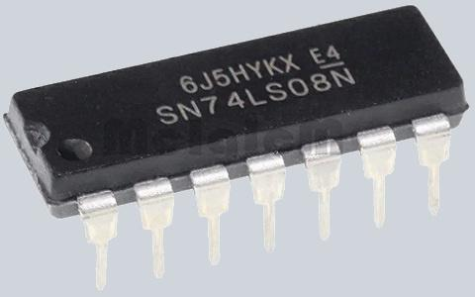
My First CPU (1984)
Simple as Possible
Use TTL Chips - 74LS series
Stick Everything in a ROM - Program + ALU
Keep it Small - 8k is a lot of money!
Basic I/O - LEDs and push buttons
Result - a “Toy” computer
Notes:
I started in the UK at Motorola and then moved here [to the US for] Nextel phone company 2G. I
started in electronics at very end of the 80s, and then eventually ended up in software. So my electronic
skills are trapped in the early '90s. So I did a lot of stuff in the 80s and [the folowing] is about my first [TTL] CPU.
The idea I had, was to build something as simple as possible, use TTL chips
(so these 74LS chips). I waned to stick everything in the ROM, so
not even [use] an ALU, just the single ROM. The program for the ALU is lookup tables. So
do everything in the ROM, keep the TTL logic as simple as possible, and then keep it really small.
Back then 8K [memory cost] a lot of money. You can solve these ALU kind of problems,
just by throwing huge amount of memory at it. But I had to keep this fairly small.
so basically, I'd have LEDs and push buttons, and build a toy computer.

Slide 3
My First CPU (1984)
ROM
I/O
Registers
Control
Logic
Program
Designed
✅
ALU
Built
❌
Notes:
My First CPU (1984), block diagram: So this is the overview [chart]. I think it had RAM but you don't even need RAM to get something really simple working. you've got a few registers, control logic and then this program of everything in it. That was actually designed on a big piece of paper, but never built.
It wasn't [proving] to be very interesting, so it was just an exercise, and then I kind of forgot all about it,
until about 34 years later.

Slide 4
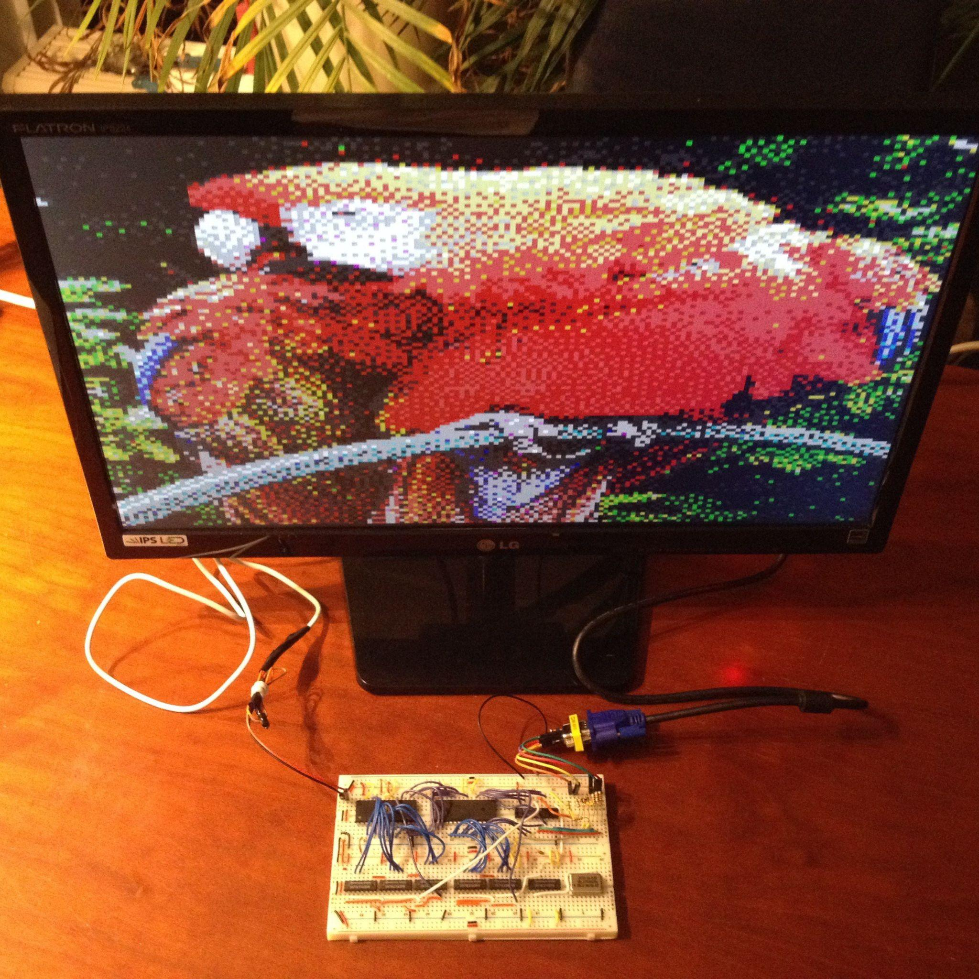
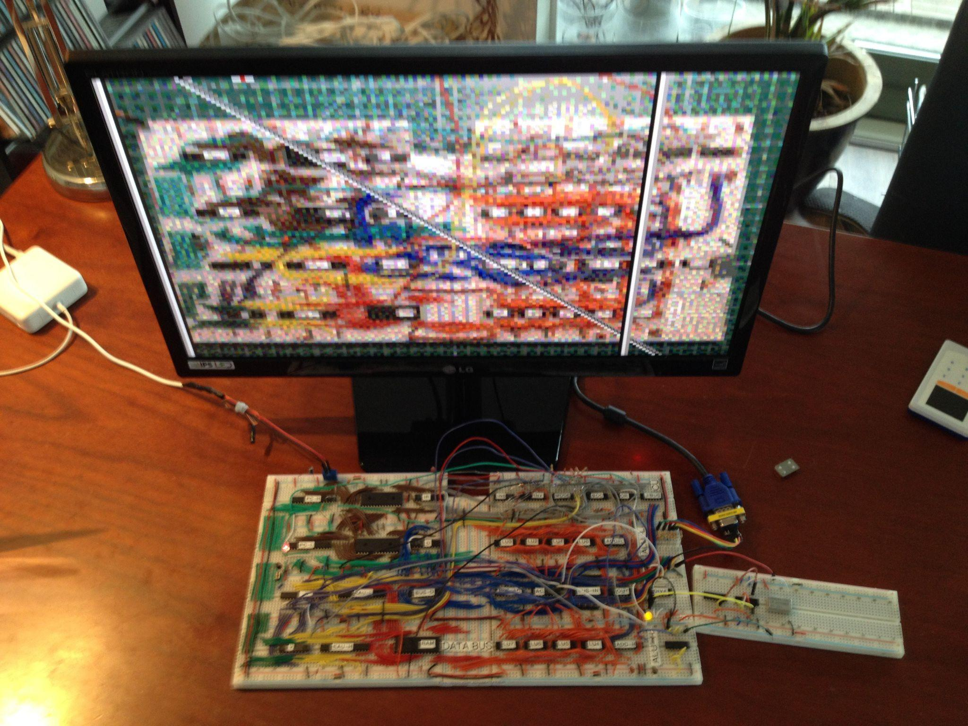
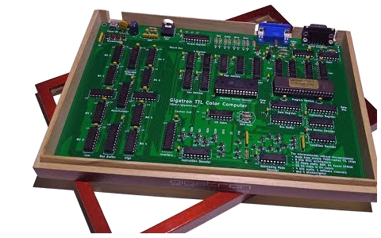
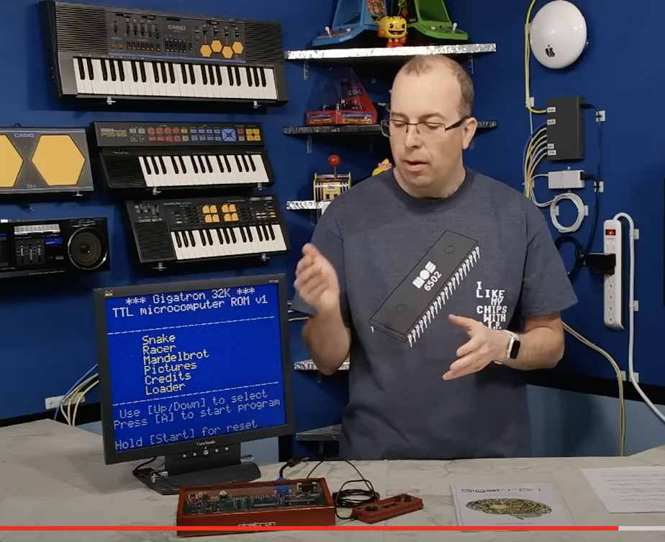
34 years later…
34 35 years later
VGA Circuit
TTL + ROM
6.25MHz
Microcomputer
CPU + VGA
in TTL
Gigatron Kit Released
in 2018
8-bit Guy
Video
Notes:
35 years later: ... There's a couple of guys in the
Netherlands, and one of them is Marcel van Kervinck.
He was playing around building a VGA circuit on a breadboard, with
TTL chips and a ROM. The actual image was on the ROM, and then just
scanning the ROM and generating a video signal, running at 6.25 MHz.
That's a quarter of the speed of VGA so it's a quarter of [minimal VGA]
resolution. Then he added a RAM chip and a microcontroller, and
eventually he added a CPU. This really basic TTL CPU was running at
that same speed. It was bit banging the actual video, so very simple.
Still, it could run real applications and he released it as a kit
[in 2018 as Gigatron.]
This is when it was released, 34 years after [my paper TTL computer]. Then there's
[also] this infamous [8bitguy.com] video*. At the end of it, he talks about his Commander X16
project. That also inspired the Stephanie alair, who built the Phoenix stuff**,
and it also inspired me. I saw it a year after the came it come out.
*“Building my dream computer - Part 1" 2019, The 8-Bit Guy, youtube.com
Also check 8bitguy.com Web site blogs.
** https://c256foenix.com

Slide 5
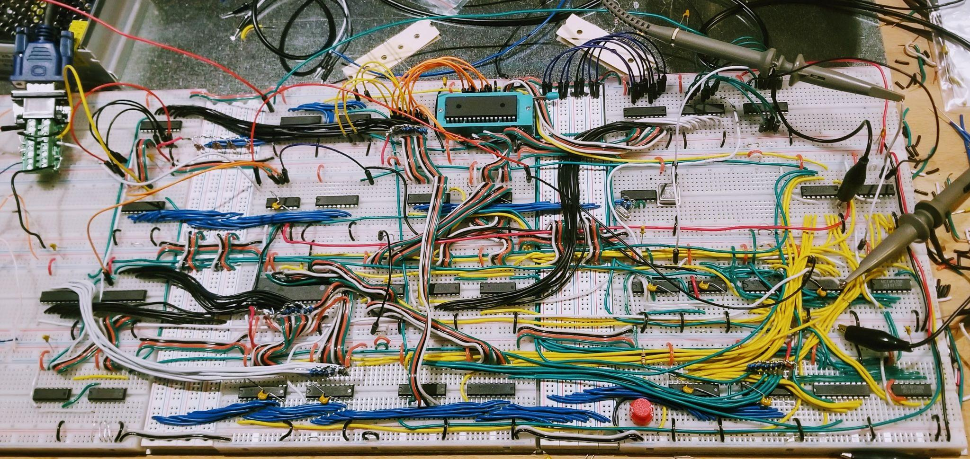
My Second CPU (2019)
Notes:
That led to my second CPU [on a breadboard]. I actually did build this .
Let me just show you [this board image. It's] basically the original
CPU. Rather than actual bit bang the video, I added a DMA controller that
scans the RAM. I call it the GPU, and it swaps RAM from the CPU [to]
this GPU. I don't have to bit bang the video, so it's not quite as horrendous
[for the CPU]. A few more chips, but the CPU section is a bit more simple.

Slide 6
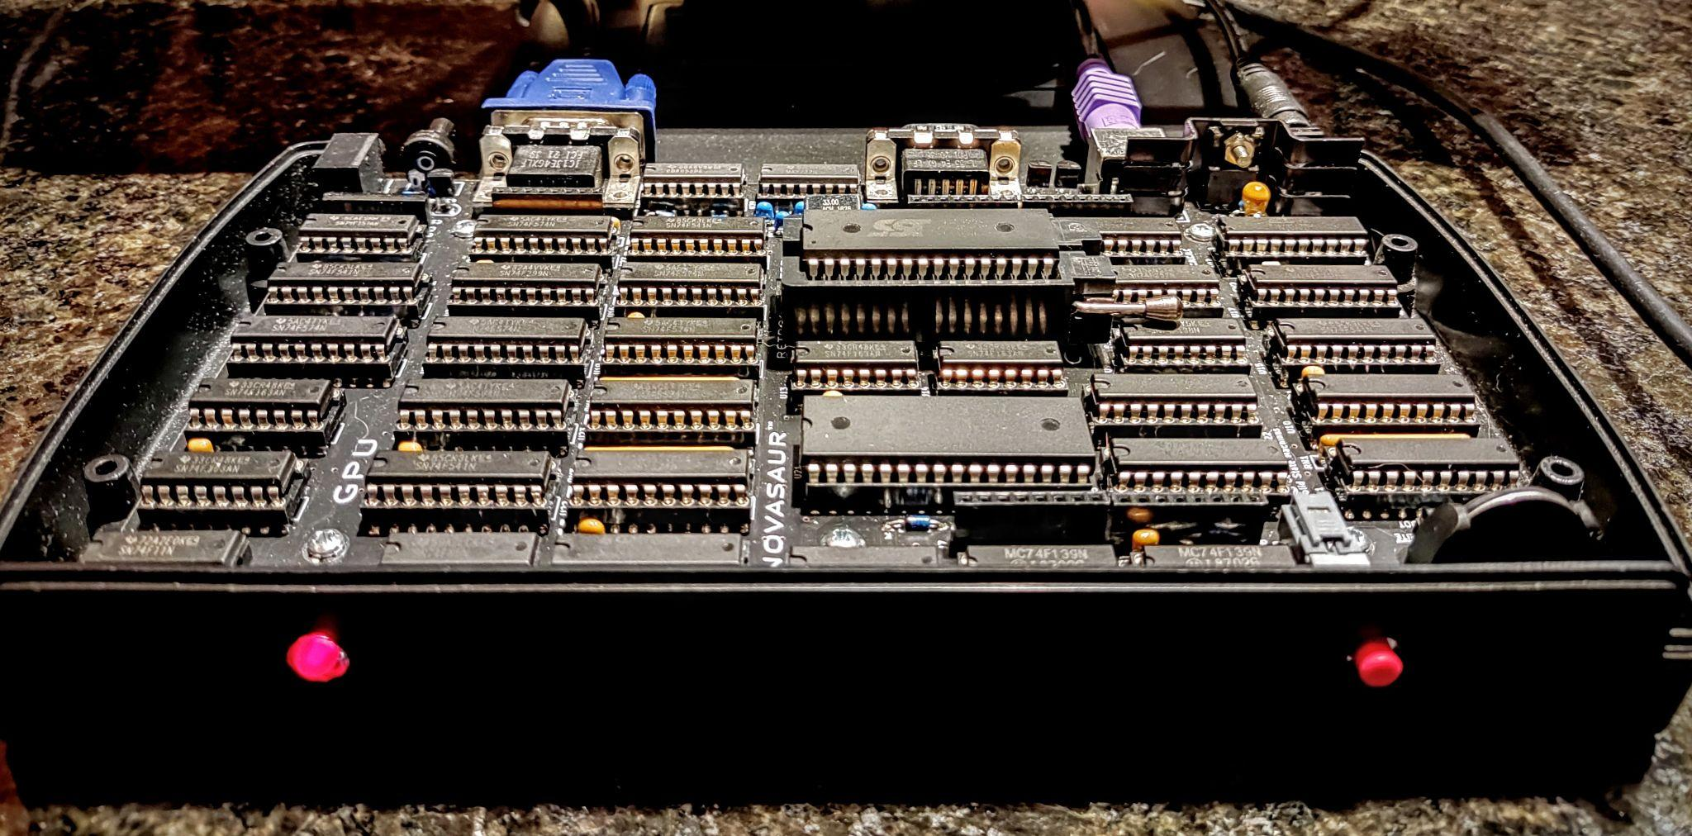
Novasaur (2022)
Notes:
So that led to the Novasaur.
I think the hardware was finished in about 2022, but there's a lot
of software to do to make this work. This is the actual [board]. There's a button, so
you push that in, and then there's video out and you should get a prompt - that's the idea.

Slide 7
Some Features
Power Switch
Power Switch
Single LED - serial RTS line
VGA video (CRT) + PS/2 keyboard
Serial Port (TTY) - supports XMODEM
250k RAM Disk - battery backed-up disk drive
Boots to CP/M prompt - 64k version 2.2
CP/M prompt
Notes:
There is a power switch, a single LED and that's actually
connected to serial RTS line, [and] tt has VGA and keyboard. The serial port
supports Xmodem, so you can transfer files to and from it . And it has a
battery-backed] RAM disk.
Some people have SD cards, but I wanted to keep it as simple as possible.
I could get a 512K RAM so half of that RAM is set
up to use as a 256k RAM disc drive. that's the A
drive used in CP/M. That's about what you'd get in the 70s on a
very low density diskette. And so it'll boot up to CP/M.
Push the power switch and that [prompt is] what we want to get to.
There's quite a lot to do to get there.

Slide 8
Power Supply
Power Requirement - 10 watts 😳
Needs 5 volts @ 1.6A 🫣
USB or Wall Wart? 🤔
Voltage Drop - high current = 0.3-0.5v 😰
Buck Converter - 24v @ 500mA 😵‍💫🥵
Linear Regulator - “6v” (5.7v) @ 1.6A 😅
Notes:
[Here’s] a quick overview. The power requirements of this board is about 10 watts,
which is quite kind of a lot. It's 1.6 amps and that's a decent amount of current.
You can get a [5 volt] USB charger or a wall wart plug that in, that's not a problem, but they're not quality ones. you'll get up to .3 to .5 volts voltage drop [at that current], and that's going to not work if you if you got 5 volts from the wall [wart].
I played around with buck converters, so you start with much higher voltage and you step it down. They tend to be very [electrically] noisy and run kind of hot. So I used a linear regulator which is more appropriate for the era. [At] 6 volts, which actually drops to about 5.7, and it's 1.6 amps, so that works

Slide 9
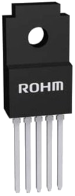
Linear Regulator
6v
5v to circuit
1.6A 🤑
Power Switch
Notes:
This is the actual regulator I use, it's a 2 amp regulator. You have a power switch which can actually be pretty expensive. but this [circuit has a regulator] so [switching full power] is not what I want [the power switch to] do.

Slide 10
Using the Enable Pin
0A
1.6A
6v
5v to circuit
Power-on Button
Notes:
The regulator actually has an enable pin. So
you connect the power to the regulator the whole time, and then push on the button
[to enable the regulator]. It's now the current [that] gets pulled through [the regulator].
So that button can be really small, and [this is] what it looks like, a little button.

Slide 11
Actual Power Circuit
6v
REG
PWR
ENABLE
10k
GND
GND
DPDT SW
10k
RAM
/CE
BATT
VCC
Notes:
This is the actual power circuit, It looks pretty complicated, but I'll
just step through what's going on. The actual power switch is a
double pole double throw [DPDT] that looks like a slider but it's a sort of push button.

Slide 12
Power OFF
6v
REG
PWR
ENABLE
10k
GND
GND
OFF
10k
RAM
/CE
BATT
VCC
4 μA
Notes:
So when it's when it's in this off state,
the ground is essentially connected to the enable pin on the regulator. So the enable is high,
so that regulator is off. Then the RAM is constantly powered up by the power
supply but also by the battery. so when the power's off it's powered by the battery. In this state
[the RAM is] powered up.
But the [RAM also] needs to be put into a standby mode. So the battery is also connected to that chip enable, which kind of holds it in this off state, and [that] pulls about four micro amps. This is actually a modern RAM chip, so it's CMOS and it can sit there in a very low current state. The CR 2032 battery can probably keep this going for about 5 years.
So now I'm going to push the button to turn it on ...

Slide 13
Power ONFF?
6v
REG
PWR
ENABLE
10k
GND
GND
ONFF?
10k
RAM
/CE
BATT
VCC
Notes:
about to turn it on ...
... but you get to sort of this "onff" state which is like it's
halfway on*. as soon as you push that button in, the regulator turns on,
because you're basically removing that low
signal. and the 6V is now connected to enable. this will power up, but the memory is
still disabled ...
*The switch geometry is referred to as "break before make", when the center position briefly
breaks contact with BOTH poles of the double-pole switch. - Herb]

Slide 14
Power ON
6v
REG
PWR
ENABLE
10k
GND
GND
ON
10k
RAM
/CE
BATT
VCC
Notes:
[ ... Memory is disabled] until that button is completely closed. that's when this
grounded 10k resistor is connected to the chip enable,. So now the memory is turned on.
This [method] is not necessarily unusual. [But] when you do power something on, the chips
are going to come up at different times. [That's] kind of a race condition.

Slide 15
Problem #1
Board powers up before memory enabled
Can it Compute? - only one register
Memory is needed - for additional state, run code
Delay power on? - possible race condition
Delay reset? - reset after power on delay
✅
But…
Notes:
So this is problem number one [- the board powers up before memory is enabled].
What you want to do, is to try and solve everything in software, [while] it's powering up
without the [RAM or ROM] memory, but can it compute? The thing really only has one true register,
in the sense [that] it's got an accumulator, and then you use the memory to be the other side of it.
So you need the memory for the additional states,
to actually run code. You can't do much on this machine until the memory is actually working.
You could potentially try and delay the power on. but there's all sorts of other race conditions there. So typically
what happens is, real computers will have a delayed reset. They power on and there'll be a delay, and it holds it in reset, and then it releases it. That's kind of one way to solve it ...

Slide 16
Problem #2
16-bit Address Space - 64k program memory
8-bit Program Counter - requires 3 chips
Program Jump - up to 256 bytes
8-bit Page Register - requires 1 chip
Page Jump - up to 256 pages
Counter reset in use - page jump resets counter
Notes:
... but there's problem number two [about computing architecture]. So the machine has a 16 bit address space but again I'm trying to use as few chips as possible. So an 8 bit program counter which requires three chips, you have two four-bit counters and then a buffer. so I have an 8 bit program counter on this, which can do a program jump which is up to 256 bytes. if you want to go further than that, there's an 8 bit page register that you load, and that's a page jump. So basically you run the code and then you jump to a different page.
It's not very efficient, but there's plenty of memory, so that kind of works. That gets the thing down to four chips. But the counter reset is in use, in a sense that, if I want to reset the program counter to zero, It's already kind of being reset by this page jump. So I need to initiate a page jump to reset it.
And that causes issues [because] I need to be in that page to do that page jump.

Slide 17
Problem #3
Page register - 8-bit D-Flip Flop (20-pin DIP)
Power - requires 2 pins (18 left)
8-bits in/out - requires 16 pins (2 left)
Clock - latch the data (1 left - pick one)
  Reset - set register to zero
  Clock Enable - disable latching
  Output Enable - tri-state to bus
🙏
❌
✅
Notes:
I need to be in that page to do that page jump….
.. so that [paging is] kind of problem number three.
The page register [is] an 8 bit flip-flop, you get that in a 20 pin DIP. There's power needed so there's
18 pins left; eight bits in and out, so that's another 16. Now you're down to two
pins on this chip. You need a clock to latch the data so there's one pin left.
So you get to pick between these [following] possible configurations.
You can have your reset, which is what we want. There's a clock enable so that ... when you're
latching data, you can sort of enable or disable that. And then there's an output enable, which is
kind of what we need because we need to tri-state this onto a bus. So ... this register has the data in it but you
don't want to have it connected to this ROM the whole time, because you also want to use it as an ALU, so you have other registers connected. So that [enable is] what we want, we don't need this [clock enable], but we really have to use this [output enable]. So unfortunately no reset.

Slide 18
Program Memory Addressing
ROM (bank 0)
BUS
BUS
BUS
VCC
Address Bus
680
Program
Counter
Page
Register
CLK
/OE
Notes:
So anyway this is how the program memory is set up, and it should be fairly simple.
There's a 16 bit address bus, the page register program counter, and there's an output enable
on both chips and a clock on both chips.
What we're going to do, is we're going to pull up the top half of this bus to VCC ...

Slide 19
Boot Mode
BOOT - single bit defines booting/running
Power-on Reset - reset to 0 (use inverted output)
Disable Page Register - /OE | BOOT
Select Boot Page - pull-up resistors = 0xFF
Run Mode - clear boot mode on any jump
Manual Reset - set boot mode
Notes:
... and then create this thing called boot mode.
Basically the boot mode is a single bit on the machine, that defines whether it's booting up or whether it's running.
On power on [during] reset I'm going to set that to zero. I actually use the inverted output
of this flip-flop, so that's going to disable this page register. The output enable is
ORed with the boot, I have a diagram showing this.
By disabling that page register in this way, the pull-up resistors will push it up to this FF state. It's never connected to the bus but the bus is being pulled up by resistors [in it's absence]. So to the ROM chip it sees the top eight bits [are] being FF.
Then ... to get into the run mode, you have to clear this boot bit to then enable that register. And
that's done by doing any kind of jump instruction. Then you can manually reset it and
get it back to that boot mode. Basically this is what's happening [during reset and start of run mode].

Slide 20
Normal Addressing
ROM (bank 0)
BUS
BUS
BUS
VCC
Address Bus
680
Program
Counter
Page
Register
/OE
CLK
boot
(off)
Notes:
When the machine is running both of these, [boot mode and run mode,] the program counter and page register [are] enabled.
[When] boot mode is off, so that's basically a logic zero. And then the output enable just works. But in the boot
mode, it's boot mode is on, that's a logic one, and that output enable never happens. and so the output is basically held up to this FF state.

Slide 21
Boot-Mode Addressing
ROM (bank 0)
BUS
BUS
BUS
VCC
Address Bus
0xFF
680
Program
Counter
Page
Register
/OE
CLK
boot
(on)
Notes:
[In summary,] when the machine powers on, this boot mode is enabled.
So it doesn't matter what's in that page register, it's always going to go to this
boot page.

Slide 22
Boot Page (0xFF)
Problem #3 - solved!
Problem #2 - program counter is not been reset
Boot Code? - can’t start at a defined location
All NOPs - every byte is a NOP (0x80) until…
Penultimate Byte - page jump instruction
Cold Start - page jump to 0x80
Notes:
So we kind of solve that problem three ... but there is [still] this problem two, which is I haven't reset the program counter. In real computers you have that delayed reset. but I've got such a limited thing here, i can't really reset my program counter. So I can't rely on the code in that boot page to work.
So what I do, [as] I can't start a define location [operation], so this [boot] page is [filled with] no-op operations. so
[when] it resets at any random location, it just scans through, until you get to the penultimate bite, which is a [page] jump instruction.
Now the next bite [following] is another no op. If it starts there, if you actually hit
this jump instruction, you're going to jump to page 80. so that takes you to the cold start page.

Slide 23
Cold Start (0x80)
Contains Boot Code - program counter is zero
Show Status - need LED since no video
Active Low LED - on by default after power up
Update E-register - turn LED off
LED Off - confirms code is running
Reset other registers
Notes:
So we've cleared the boot mode, and now it's reset the program counter, and it's
loaded the page register to 80. and that's where the actual boot code is, starting from zero.
So we've still got a long way to go. We want to show a status of what
state the machine is in.
So we need to use the LED .. since there's no video. The LED is [wired] active low so basically. when the machine powers up that LED is on. If you remove the ROM or the thing's completely dead, that LED will come on.
That LED is controlled by this E register that I have. I call it the E-register like an extended register.
So the first thing I'm going to do when this machine starts running, is turn off that LED.
If it turns off, then you know that the code is now running. So when you power this thing up, push the button in,
if that LED goes off you know that the actual code is now running. it's gone through this boot mode.
It's cleared that boot page, now it's running this cold start code. it also resets some of the
other registers.
So now the machine is kind of at the point where it can start, it's actually running real code now.

Slide 24
Preflight
Problem #1 - verify memory writable using code
0xAA → [0x10000] - write 0xAA to memory
[0x10000] $ 0xAA - read memory XOR with 0xAA
ZERO? - result should be 0x00, else restart
Repeat with 0x55 - write/read and XOR 0x55
ZERO? - memory writable (solved?), else restart
Notes:
So there's a thing I call pre pre-flight. [There's]
this issue where the RAM isn't necessarily enabled yet, so we can't really
run real code. So we need to verify whether we can write
to the memory, before we can actually run useful code.
And [verify] is pretty simple (I know this looks maybe a little bit complicated). but basically I use this bank one and I write AA hex to it. Then I've got very limited instructions I can use, so then I just exclusive OR that result. So I push it in the memory, read it back and then exclusive OR with itself which will result in a zero. and if it's zero it's going to move on,
else it'll just restart. so it just sits there and runs at this very very fast rate, just
trying to write to memory.
And if it can, it's [still] possible you might actually have this AA value in that register to begin with. So it does the same thing but with 55 which is those AA bits reversed.
if [that result is] zero then the memory has been written to, and it moves forward, else it just sticks in a loop.
So we're running code, we've verified we've written to the memory.

Slide 25
Memory Test (bank 0)
0x00
0x01
0x02
0x03
…
0xFE
0xFF
Page
LED
ON
LED
OFF
0x00
0x01
0x02
0x03
0x04
0xFF
0x00
0x00
0x00
0x00
0x00
0x00
0x00
0x01
0x02
0x03
0x04
0xFF
0x00
0x01
0x00
…
0x01
0x02
0x03
0x04
0xFF
0x00
0x00
0x00
0x7F
0x01
0x02
0x03
0x04
0xFF
0x00
LED
OFF
LED
ON
0x00
0x80
0x01
0x02
0x03
0x04
0xFF
0x00
0x00
0x81
0x01
0x02
0x03
0x04
0xFF
0x00
…
0x00
0x01
0x02
0x03
0x04
0xFF
0x00
0x02
0xFF
0x00
0x01
0x03
0x04
0xFF
0x00
Notes:
.. and then I do a proper memory test.
The LED was on, it's turned off, I'm now turning it on again, and I just start filling the memory.
I actually fill location zero with one two three like this [in locations 0 1 2 ...]. Then I run this code
right up to the whole 32K of this first bank of memory. Then turn the LED off and then
just do that exclusive OR thing, to clear the entire memory. Then if any of these bytes are zero,
it just reboots, goes right back to the beginning, does that pre-flight test, repeats on the upper
32k and then it's good.
So [now] the memory is writable, it's filled the whole memory with all the zeros.
This is kind of part of the reset, it's just clearing the memory, it's verified
[that] it can write to every bite. It really stresses the machine as well. So if it passes that
memory test you know it's working.

Slide 26
Reset Keyboard
Toggle LED - turn LED On after memory test
Toggle PS/2 Clock - data/clock low, then release
Acknowledge - keyboard brings clock low
Retry 6 times - restart from toggle LED
Send Reset - PS/2 command 0xFF
Pass/Fail? - continue to “warm start”
Notes:
Now there's a PS/2 keyboard plugged in. So it's part of the boot process.
If you're going to use that CRT interface, in other
words the video VGA output, and then the actual keyboard, you need to try and reset that (keyboard)
Again I toggle the LED to show something's happening. Then I have to toggle the PS/2 clock, and
then the keyboard should acknowledge that. It brings the clock low and then I'm going to retry that six
times. If it fails it it'll go back to the beginning.
so it's going to sit there and it flashes the LED on and off until it is rebooted. if it doesn't work it doesn't matter, it just moves on it sends this PS2 reset command either way. Well - if there's an acknowledgement for the keyboard it
resets. Pass / fail it will then continue, and it goes on to the next routine which is the warm start.

Slide 27
LED Status Recap
Solid On - board dead (no ROM)
Solid Off - Preflight fail (no RAM)
Constant Flashing - RAM fail (timing issue?)
3-4 Slow Flashes - Normal, RAM pass, Kbd fail
2-3 Quick Flashes - Normal, RAM pass, Kbd pass
End State - Assert RTS (serial enabled) = Solid On
Notes:
So if you turn this machine on - you can literally
take the ROM out of it, power it up it's not doing anything, the LED is going to stay on the whole time.
[With the ROM in place,] if the LED goes off and stays off then it's failed this pre-flight, it's not writing to the RAM. So this will happen if you pull the RAM out. If it's constantly flashing, then it's basically failed that memory test. And if the timing goes, if the board's not timing right, this will actually happen where it'll just keep flashing. So if there's an issue with the timing, it's not able to read and write to the memory very efficiently.
Three to four flow slow flashes, is what happens if you don't have the keyboard plugged in. So it's kind of doing that keyboard reset, and not being able to complete. If [instead] you have these quick flashes and then it works, that means the keyboard's working.
So that's the whole boot up process on the LED. The end result is that LED is now on. so you
push that button, it flashes a few times, and you can kind of tell what's going on. if it's solid on at the end then it's all good.

Slide 28
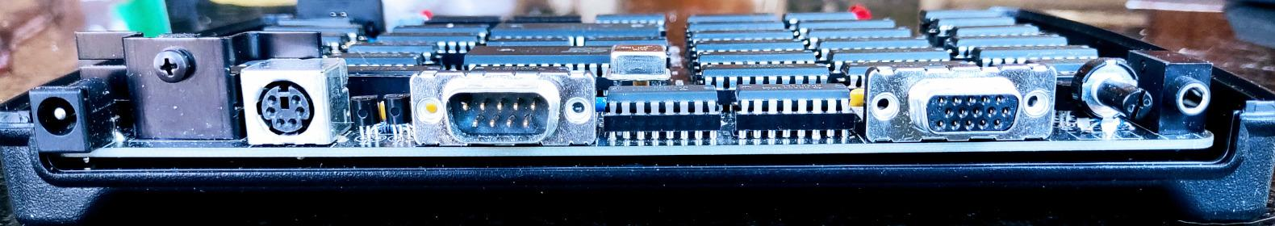
External Interfaces
Keyboard
Serial
Video
Audio
PS/2
US/English
RS232
CTS/RTS
VGA, SVGA, XGA
60,75Hz Refresh
3 Voice, 1 Noise
ADSR
Notes:
So I'm going to talk a little bit about kind of what's going on under the covers.
'Cuz even though this is a very simple TTL CPU, there's a lot of stuff running on it. So once it's booted
up, now we're going to start bringing up other parts of the software.
But there's very limited hardware and there's all of these interfaces it has to manage.
There's no video chip or serial UART or keyboard controller. There's audio but no sound chip. everything is bit banged.

Slide 29
Hardware Abstraction Layer (HAL)
Simple Hardware - bit bang everything, all the time
Critical Timing - video, audio, serial, no yield!
Fixed Timing - all code is a multiple of 43 cycles
Harvard Architecture - program memory is ROM
Virtual CPU - interpret RAM as 8080 byte code
Abstract Interfaces - expose via 8080 ports
Notes:
So there's this thing I call the hardware abstraction layer which is basically code that's running. It's very simple
hardware, bit bang everything all the time, and you can't yield to a user's program it's very critical timing. so you have to use this fixed timing, where all the code is a multiple of 43 cycles*.
[*Cycles are a product of the VGA video horizontal timing, the 9600 baud serial timing, and the digital audio sampling rate. These operate in lock-step through the code as it's paging itself. Explanations follow. - Herb]
So this sounds like ridiculous and it is, but every single piece of code is written to fit into one of these 43 cycle blocks. And it all has to be fixed timing. at the end of one of those blocks it has to dispatch, to figure out what to do next.
it can't [deviate,] it has to follow a very specific set of timing.
The other thing, is this is a Harvard architecture. There's two RAM chips and it has separate address spaces. [But]
the program actually runs on the ROM. So you can't put a new program on there without taking the ROM out and
programming it, which isn't great.
What I do, is I build an interpreter [code] that reads the RAM, and then interprets that [RAM] as [Intel] 8080 byte code. That's how the thing is actually running, pretty much at that kind of user level. You wouldn't normally write [ROM] machine code that runs on the hardware, it's just too much of a pain, and you'd have to deal with all this timing,
[So then I can software] abstract all of these interfaces on the board. I essentially just map them to
this abstract interface, and they show up as 8080 ports. So you can read the keyboard just by going to one of these
ports or the serial and then you'll just see the next bite that's available. so that code that's running is providing all those services.

Slide 30
Virtual Machine Cycles
S
B
1
2
3
S
4
5
6
7
S
8
9
10
11
S
12
13
14
15
5 VMCs/video line
38.4k lines/second
SVGA = 37.9k (1.3%)
Start with Sync
Block cycle on line 1
Fetch/execute 8080 instructions.
4 lines/block
9593 blocks/second
serial = 9600 baud
audio = 9.6kHz
160 blocks/frame
frame rate = 60Hz
15 VMCs ~= 6 instructions per block
Notes:
The way the timing works, is that I have what I call this virtual machine cycle.
So the [virtual] machine runs at 8.25 MHz. if you divide that by 43 you get 192 kHz more or less. so each one of these little cycles is one over 192 kHz, and then I divide that down.
The video is basically super VGA. ["S" blocks on diagram]
so if I set this up so each one of these lines of virtual cycles is five,
then I get 38.4 kHz or 38.4 thousand lines per second.
and that's very similar, 1.3% away, from VGA. so most monitors are happy
with that. Each one of these lines starts with a sync pulse that generates
a horizontal sync, that the monitor latches onto. and then block one has this extra cycle
[B] called a block cycle, and that just kind of makes sure it counts up which block it's on.
Then all of these kind of cycle[-blocks] with numbers in them,
each one of those are available to run 8080 machine code. In those
15 virtual machine cycles you can run about six [8080] instructions. so you need
one cycle to fetch and one or two cycles to execute, the actual byte codes of the 8080.
So it comes out to about 60,000 instructions per second which is about 1/5 the speed of an 8080.
These blocks are set up to divide the thing further down. so each block has
four lines in it. so you get 9593 blocks per second. so the serial is 9600 so
that's close enough that works. the audio is sampled at 9.6 kHz so that's again
done on that block level. And I do 160 of these blocks per frame, which is 60 Hz
[the USA horizontal frame rate].
So that's how the timing works. So [users] don't ever touch this,
You just write the code to run as an 8080 and then these
available 15 virtual machine cycles will execute that code.

Slide 31
Warm Start
Software Reset - clear run state (not RTC)
Kernel Mode - disable context switching, CPU ID=0
Prefetch Instruction - “CopyROM(0, 0)”
Reset Program Counter - PC = -1 (0xFFFF)
Start HAL - jump “block sync” page to start video etc
Boot moves to 8080 code
Notes:
So the warm start is going to have to set up this kind of virtual machine. [First] there's a software
reset basically happening, where it clears the run state. So the hardware is running now.
[Then] I have this thing I call kernel mode. so I went a little bit further here, where I
have 512k of memory, and I break it into eight banks. So bank zero is the [VGA] display and
the other seven banks are assigned to seven separate [virtual 8080] CPUs. so bank number one is used for this
kernel. I have this context switching that can happen, so that's all disabled [on warm start].
I prefetch this instruction called copyROM, and I'll explain what that is. Then I reset the virtual program counter.
It's actually set to minus one, because it prefetches the next instruction and goes up to zero. and then I start the
hardware abstraction layer by calling this block sync [page]. So in that block of virtual machine cycles, I just call the code that runs that first one and then the whole timing takes over. Now the machine's running in this kind of next-layer up, which is this hardware abstraction layer of virtual machines.
The boot was running on the actual kind of hardware, and now [it's] running in this kind of virtual machine,
so it's now moving into the 8080 code. From then on in, it's always fixed timing [per page], and the video signal starts to happen. That's when the VGA monitor is going to start to [see] sync.

Slide 32
Copy ROM
256k ROM
512k RAM
PROGRAM
MEMORY
COLD STORAGE
DISPLAY
KERNEL
vCPU1
ALU/
FONT
ALU
CPU2
CPU3
CPU4
CPU5
CPU6
CPU7
Program Memory - native machine code (runs on HW)
Cold Storage - 8080 machine code to be interpreted
Notes:
I just want to talk about this copyROM, this instruction is used a lot.
One of the issues with this Harvard architecture is that I have the code
in this program [ROM] memory, which is what actually runs on the machine. but I want to run 8080 machine code, that has to be copied into the RAM. And so I have a special instruction that allows me to copy from this second
bank of [ROM] memory. I can copy [from] there into any of these [virtual] CPU kind of locations.
so that's a special instruction, and I call it copyROM. and so there's a lot of stuff [to consider].

Slide 33
Cold Storage (8080 code)
BOOT - Bootstrap (1 page) →0xn0000 (0<n<8)
DISK - RAM Disk (1 page) →0xmFF00 (4<=m<8)
KERN - Micro Kernel (6 pages, 1.5k) →0x1F000
MON - Monitor (6 pages, 1.5k) →0x1F600
SYS - System Library (4 pages, 1.0k) →0x1FC00
B: Drive - CP/M 2.2 and utils, IMSAI Basic (60k)
Notes:
So this cold storage area contains all the 8080 code and I'll go through this kind of quickly.
But basically there's a bootstrap code, there's code that runs this RAM disk. i have this kind
of micro kernel, and then there's a monitor code as well. I have some system libraries I can use. and then I have like a B drive, which contains all the CP/M utility [programs]. so again that's in this cold storage ROM, and it can be copied over and then look like an actual kind of B drive that's full of 8080 code.

Slide 34
Bootstrap
ROM (bank 1)
RAM (any bank)
Page 0
COLD STORAGE
vCPU
run
Notes:
So the bootstrap in its cold storage page zero, gets copied to RAM page zero.
and then it starts running the code from location zero. so now what's booting
up is an actual 8080. and it's starting from zero, which is the normal way it resets.
And it's running the code in this sort of virtual CPU.

Slide 35
Bootstrap Code
BootCPU - prefetch CopyROM(0,0), reset PC
Fork on CPU ID - value of accumulator on boot
  0-1 - BOOT ALL (warm start) / KERNEL MODE
  2-3 - BOOT CP/M (TTY & CRT)
  4-7 - BOOT DISK
  8 - MONITOR
BOOT ALL
Notes:
… and that bootstrap code, starts basically with that copy ROM resetting that virtual program counter.
and then that that code will then fork, based on a CPU ID. so I have
these seven [other] banks and each bank maps to a specific CPU that's going to run, and
it context switches between them.
So if it's a zero it's going to boot everything,
a one will boot this kernel mode. Two and three will boot up CP/M,
one instance that's running that's showing the [video] display, and then one instance that runs
[using] the serial interface. so there's two instances of CP/M running. and
then four through seven run this RAM disk. [Note: these are all 8080 code I think. - Herb]
So the thing about the RAM disk is, if your machine crashes it could
write all over the RAM. so by doing this segmentation where I have separate CPUs,
you can crash your program and it's never going to touch the RAM disk, because that's a separate program that's
running. You can do it by messing with [power cycling] and kind of crashing hard enough.
But [otherwise] it's a cheap way of doing protected memory with a bunch of TTL chips.
Then there's a sort of fake CPU 8 which will run this [8080] monitor [code].
So what I do, is when it boots up, what that warm start does, it's going to initiate one of these CPUs with ID 0
which tells the machine to boot everything.

Slide 36
BOOT ALL (CPU ID=0)
Boot Other CPUs - call “BootCPU” for CPU ID 2-7
CopyROM - ROM page 0x02-0x17 → RAM page 0xF0
Boot Kernel - call 0x1F000
  Clear Memory - reset kernel state
  Set Context - 1,2,3,4, 1,2,3,5, 1,2,3,6, 1,2,3,7
  Start Event Loop - listen to messages, run timers
Notes:
… and that “boot-all” will basically run a loop. so this is where it gets a little bit complicated.
So you've booted up the actual hardware, it's now running this virtual machine. that first warm
start will start this CPU zero, which will basically start one of these CPUs,
that then tells the other CPUs to boot up. so CPU one starts and it's telling
all the other CPUs to start up. it does this copyROM so it basically copies
this kernel code that it's going to run, and then it boots that. and it clears its memory and then it
sets this context.
So this thing actually does context switching between these different CPUs and it goes 1 2 3 four,
and then the next block has 1 2 3 five, then six, and then seven. so four five six seven are actually the quad, almost like quadrants of a disk. and then one is this kernel, two and three are the CP/M instances. so it's just scanning around [blocks].
But now that the first CPU started up, now all the CPUs are going to start running.
And then this kernel has an event loop so it's listening for the other CPUs.

Slide 37
Software Stack
Application
User Program
CP/M
BIOS
Micro Kernel
Disk
Timers
TTY
Console
Hardware Abstraction Layer
v8080 CPU
Hardware
Keyboard
Serial
Video
Audio
Notes:
So this is actually the software stack.
You've got the hardware [layer] with the interfaces. [Next there's] this hardware abstraction layer that starts running, and that's doing all of this timing, basically bit banging these interfaces. and then it's running this virtual machine, but your program doesn't necessarily have to run on that. This micro kernel [layer] runs, it's basically
talking to the hardware. and then you have your CP/M which talks to this [lower] kernel [layer],
and so [the kernel] talks to the disk [and other virtual devices].
So this is a way of doing this memory segmentation and
management, to make sure you can't crash and mess up the RAM disk.
Each of the CP/Ms talks to this kernel which passes messages to and fro.
Then the [8080] application will run on top of this.

Slide 38
Software Stack
Kernel Mode
User Program
Hardware Abstraction Layer
v8080 CPU
Hardware
Keyboard
Serial
Video
Audio
Notes:
But there is also a mode where you can actually run directly on this hardware abstraction. You just have this one CPU that runs [what I] call that kernel mode. And that's if you're running a game, that's how you'd run that. But when [the machine] boots up it boots up all of these layers and gets [to] CP/M.

Slide 39
RAM Disk (A: Drive)
CPU 4
CPU 4-7
TRACK
250 pages
128 , 128
Notes:
So this an example of how [RAMdisk] CPU 4 is set up. So I'm not sure if [this graphic] makes any sense.
Each line is a [RAMdisk] page, it's split into
two halves so there's CP/M records of 128 bytes. The one on the left
contains one set of records the other one on the right [the other set]. but 250 pages in each
one of these four CPUs that run [the RAMdisk].
The way I set it up is that you've got sort of like four quadrants of a disc, so 250 pages,
so that's 62.5K. and then there's four through seven,
each manages kind of a quarter of this virtual disc. so that's 250k in total.

Slide 40
BOOT DISK (CPU ID=4-7)
CopyROM - ROM page 0x01 → RAM page 0xFF
Boot Disk- call 0xFF00
Start Event Loop - listen to kernel messages
  GET - read a record from memory
  PUT - write a record to memory
  CHK - recalculate ECC of records
Notes:
… and the boot disc [code] is fairly simple.
it just copies this page one to the very end of memory, which is where it runs that code.
and it starts an event loop to listen to messages from the kernel. so it can get a record put a record. and I've also got an ECC checking in there, to make sure that the [RAMdisk] records are hopefully correct. It can
identify something's that's got corrupted, basically. It can fix up to one bite, but in general this will
tell you if something's got messed up.

Slide 41
A: Drive Read
RECORD
RECORD
CP/M
KERNEL
DISK
Kernel Copy
GET ?
GET 5
RTN 2
RTN ?
2 1 5
Notes:
So I'm just going to show you what's happening [on RAMdisk drive read]. And it's kind of ridiculous, because, you know, this is running on TTL chips.
I've got these virtual CPUs running, and then the CP/M is going to
talk to the disk, which has to be its own virtual thing. so the CP/M will send a message to the kernel, so it's it's
essentially saying, I want to get a record and this is the track and this is the sector. The kernel knows where that
lives, so it'll figure out, oh that's CPU 5, so I think that's
quadrant 2. And then that disk has its own protected memory. so it copies that record in there,
returns, It doesn't know where that [record is] going so, it just returns that message back to the kernel.
And then the kernel will copy that, so [the kernel] knows where that's going and it'll copy that.
The kernel is allowed to do this, where it can copy
from some protected memory used by this CPU, to protected memory used by that CPU.
And then it sends this return message back to CPU 2.
Then that CP/M will copy that from its protected memory.
So this way, the kernel can move things between CPUs, but again it's separate protected memory. This is the
way that the actual CP/M would go and get a disc drive [sector], rather than talking directly to the memory or to some sort of [hardware]. It's communicating and it's basically the structure of a micro kernel. It's actually not too slow it can do about 5 kilobytes per second, which doesn't sound great, but you know you've only got 64K. Typically the files you're going to be loading [are] up to say 60K. it's the biggest CP/M file you're going to load. So that's going to take about 12 seconds.

Slide 42
CP/M (CPU ID=2, 3)
CopyROM - ROM page 0x58-0x73 → RAM page 0xE4
Set IOBYTE - CPU ID determines TTY or CRT
Boot CP/M - call 0xFA00 (CBIOS COLD BOOT)
  Clear Screen - CRT instance sends CLS command
  Print Logo - copy logo from boot page + copyright
  GOCPM - select A: drive, call CCP
Notes:
So yeah, CPU two and three are two instances of CP/M. It copies the CP/M off the B
drive, which is higher up in this cold storage ROM. I put it in location page E4 and above. It also sets
the IO byte. So basically the CPU ID is used to set this IO byte, which tells CP/M
whether it's going to the keyboard or whether it's going to the serial. and then it boots the CP/M.
so it's just a standard CP/M BIOS cold boot.
so these two CPUs boot up actually together pretty much in sync. The CPU that's managing the CRT
actually sends a message to the kernel to clear the screen. I used to have the kernel clear the screen when it
booted up. but I [now] have the initiation of that coming from CP/M,
and that's fixes a bunch of different problems.
I print the logo on [the CRT] screen, so I actually have a
little logo that's in the boot page and it copies that, [then] puts the CP/M copyright.
Then it calls GOCPM which selects the A drive and then calls the CCP,
which is the console command processor.

Slide 43
Console Command Processor
Start CCP - set up CP/M to receive commands
  RSTDSK - reset disk system
    LOGINDRV - load A: directory (conflict?)
Block on input - wait for a command
  Call BIOS - CONIN
    Call Kernel - CMDSND(CONI)
Notes:
So starting the CCP sets up CP/M to receive commands. So this is now CP/M running. we've got up to the stage where CP/M is booting up as normal, and you actually have two instances of it. [Each are] able to talk to the kernel that talks to the disk. So on that start CCP, it calls a function within CP/M called reset disk (RSTDSK). and then it logs in the drive.
So when you start CCP, it will call this login drive, and that loads the A directory. this was a really difficult bug that I had to deal with. I wasn't sure what was going on. but what was happening these two CP/Ms started up and then one was going to the A drive
through the kernel saying I want this record. and then the next one was doing it. and it was actually causing a conflict where it was sending the message but that disc quadrant was already busy so it lost that message. and it would kind of get messed up. and that's one of those bugs that took a few weeks to figure out.
So there is like a actual multitasking CP/M. but this is two
instances of CPM 2.2 running on the same hardware, but they don't know about it. so
there are some potential issues. But it seems to work, um, most of the time.
Basically that command control processor which is part of CP/M, will block on input. so now it's just waiting
for a command to happen. So [one CPU] instance is looking at the serial and then [there's the] instance
that's working, looking at the [PS/2] keyboard. CP/M calls this BIOS function
called console in, (CONIN) and then that actually sends a command to my kernel, and I call
it coni.

Slide 44
Kernel “CONI” Code
IN CONSOLE - get next keyboard char from HAL
MOV E, A - store in E (could be null), set A = ^P
OUT CONSOLE - send Data Link Escape to console
  Flash Cursor! - periodically toggle “_” if char = ^P
IPCSND - return char back to CP/M
  Null? - CP/M repeats kernel CONI command.
Notes:
and I call it coni. and that CONI code basically calls the 8080 instruction IN on the console.
so this is one of these ports which abstracts in this con[sole] context, it's the keyboard.
So it's basically looking at the next byte in a buffer that's coming in from the
keyboard. and then it puts it in the e-register, because it wants to output something.
So it sets this control P character and then it writes that to the console.
(And it makes no sense to actually do that, because [ASCII] control P is data link escape,
which has got nothing to do with the console.) So the console interprets that as flash cursor.
So we now got a flashing cursor, so you finally got there [to the CP/M cursor].
you're just sending lots of control P's and then it will, depending on a timer,
it's either going to show the console the underscore or clear it. Then it's there's this IPC send
instruction that kernel sends back to CP/M if it does get a character, which could be null
and if it's null then CP/M calls back again.
So [now] you got the CP/M running and it's just blocked on
input and it's just looking for input. and then if it doesn't see it, it's flashing the cursor and waiting for
something to happen. And that's how we’ve got a flashing cursor.

Slide 45
Project Status
Jan 2022 - hardware complete
Aug 2023 - software complete (buggy)
Nov 2024 - software complete (tested)
May 2025 - kit release
Future - assembled version
Ongoing - disintegrated version
Notes:
It's kind of interesting, like from that pushing that button to it starting up,
like how much stuff is going on. It gets sort of quite difficult to solve some of those hardware problems.
Then once the software gets going there's a lot of moving pieces that have to kind of happen.
So it's quite a big stack of stuff.
So to the actual project [by date and task]. That picture of the board, that was about January 2022.
So this is a ridiculous hardware project. I mean it's a ridiculous hardware project but an
even more ridiculous software project. because it just turned into this big science project, to see if I could do a
preemptive multitasking thing.
So I'd say the software was kind of complete August 2023. but it was kind of buggy and a lot of weird race conditions, so November last year [2024] I'd say it's actually complete and tested. so it's could potentially ship out, but then a lot of things been going on. I'm hoping by the end of this month [April 2025] to [ship], I've got inventory and I'm
going to have a kit available. But the madness continues .... I could do an assembled version as well.

Slide 46
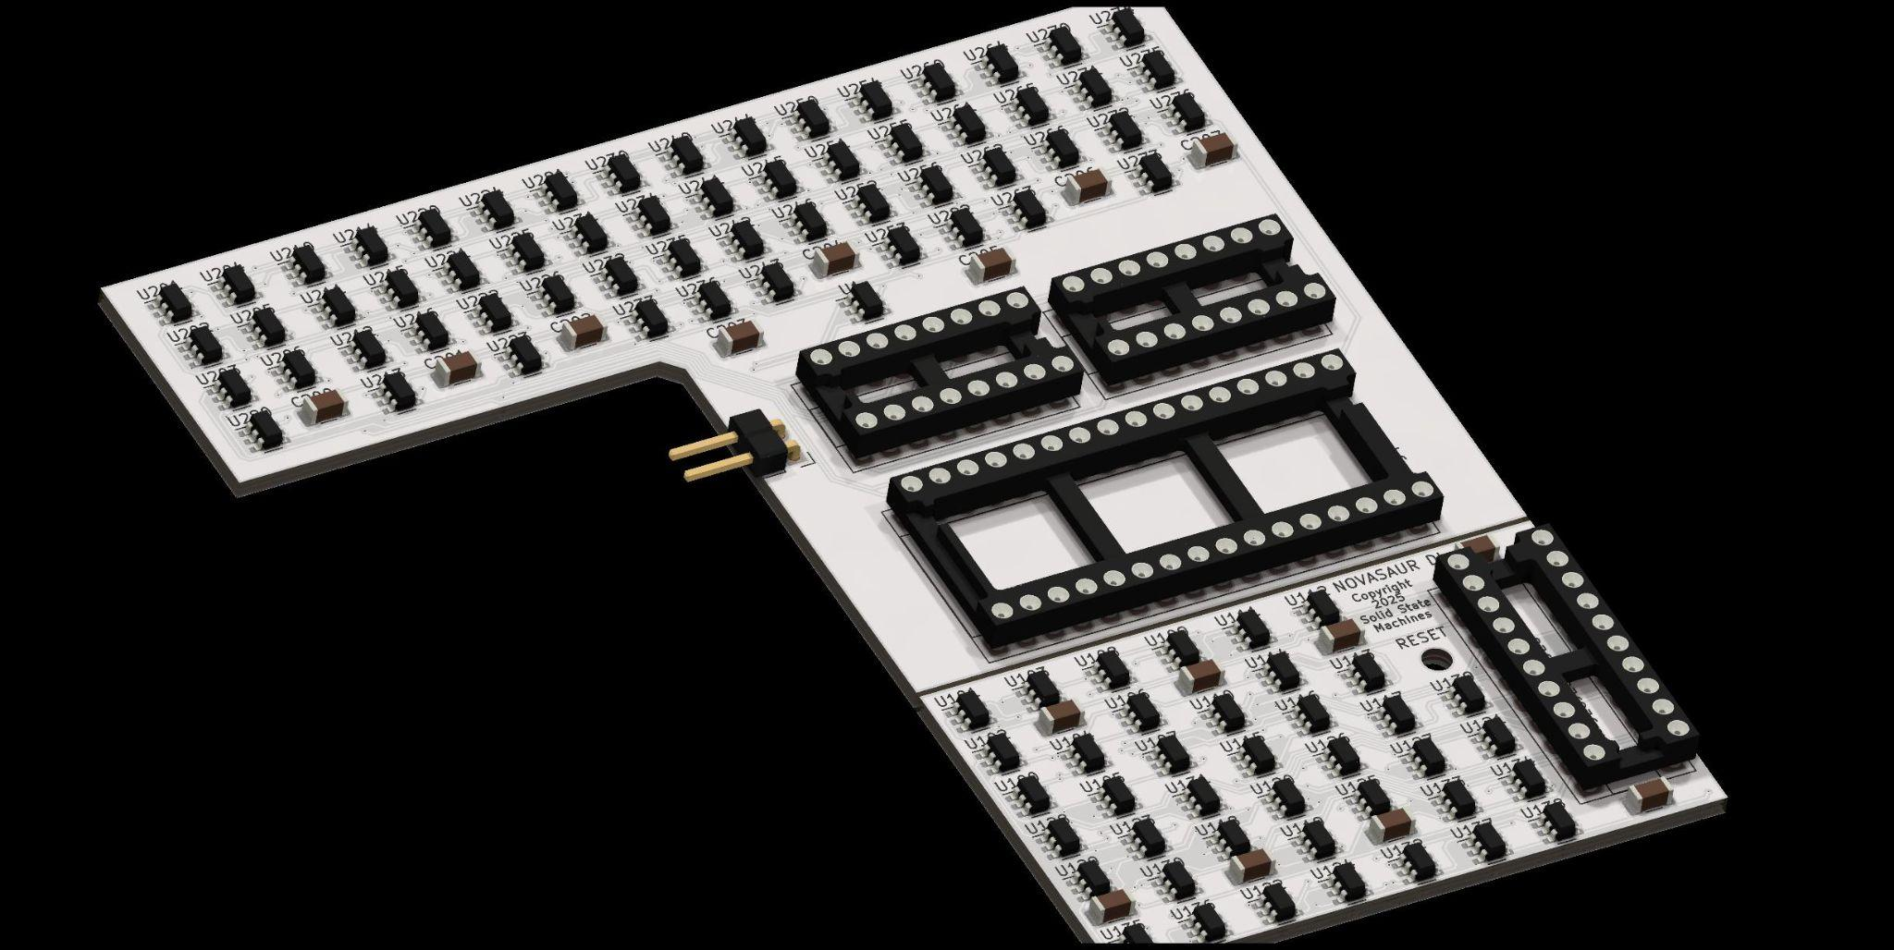
Disintegrated
Notes:
But there's this [additional] idea of doing a "disintegrated" version.
Instead of having the TTL chips, you can get these little SOT23 [chip packages], these would be individual gates. Some people do
[logic] stuff out of transistors [but] it would just be way too slow. These SOT's are actually pretty modern things, and they can do like three nanosecond propagation. so these are really going to be flip-flops and AND gates, OR gates or exclusive-OR gates; and there would be about 350 of them.
And this [image] is a test board, and this is actually arriving on Monday [mid-April]. At the bottom [of it]
there you've got .. One of the pieces of the circuit has a lot of logic, so it's [contains] some timing critical issues. so I built a
version of that [which] will plug in to [the TTL prototype board], and see if that runs. and then the rest of it, this is actually the
program counter and that's probably the most complicated piece of logic. and that would replace the ROM and these two program counter chips.
So if this works then it's not too far to then convert the entire thing into a giant-like board with just logic gates on it,
which will run CP/M. Um, but that's down the road.

Slide 47
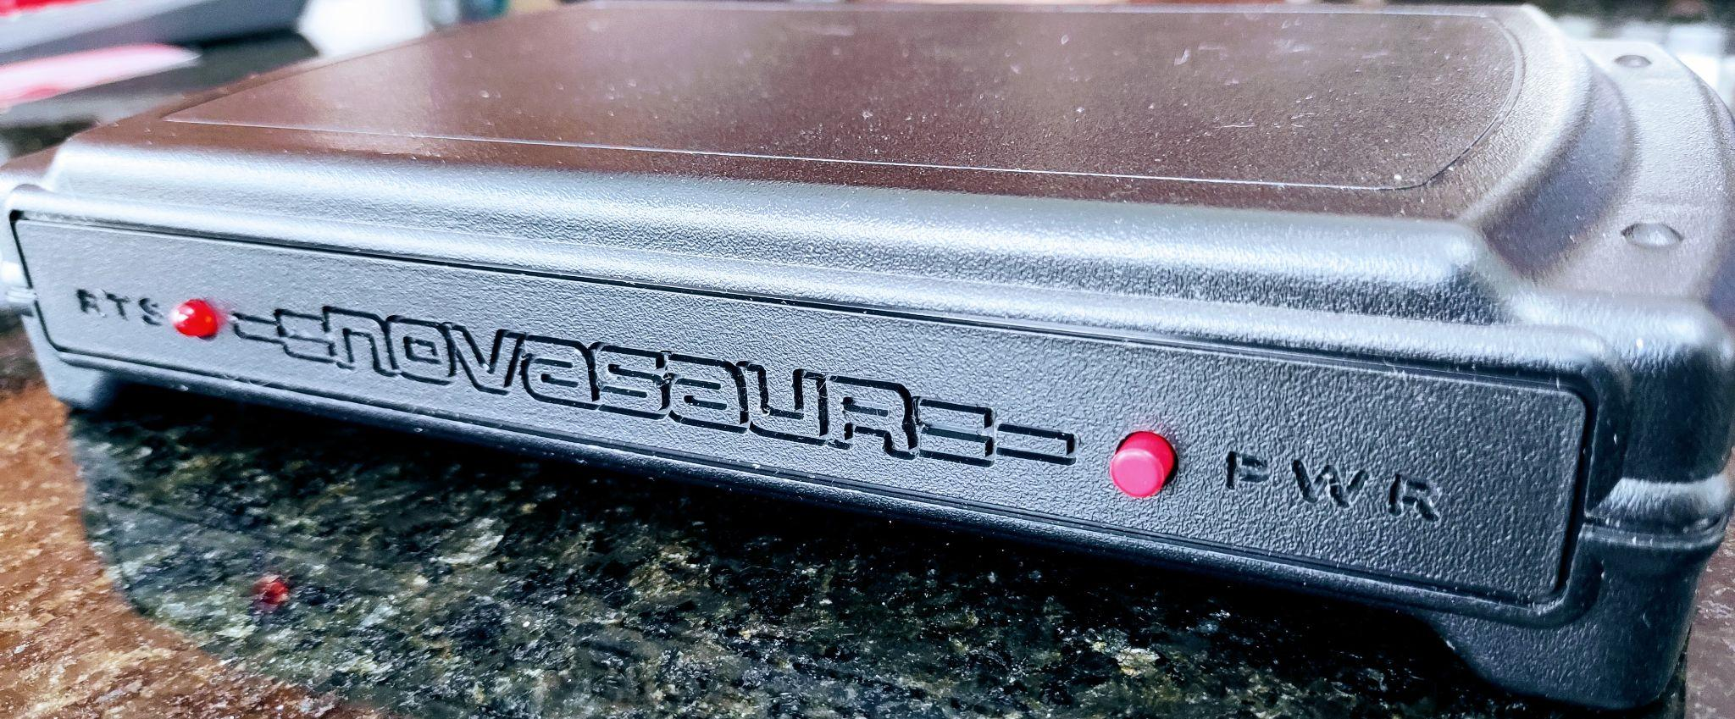
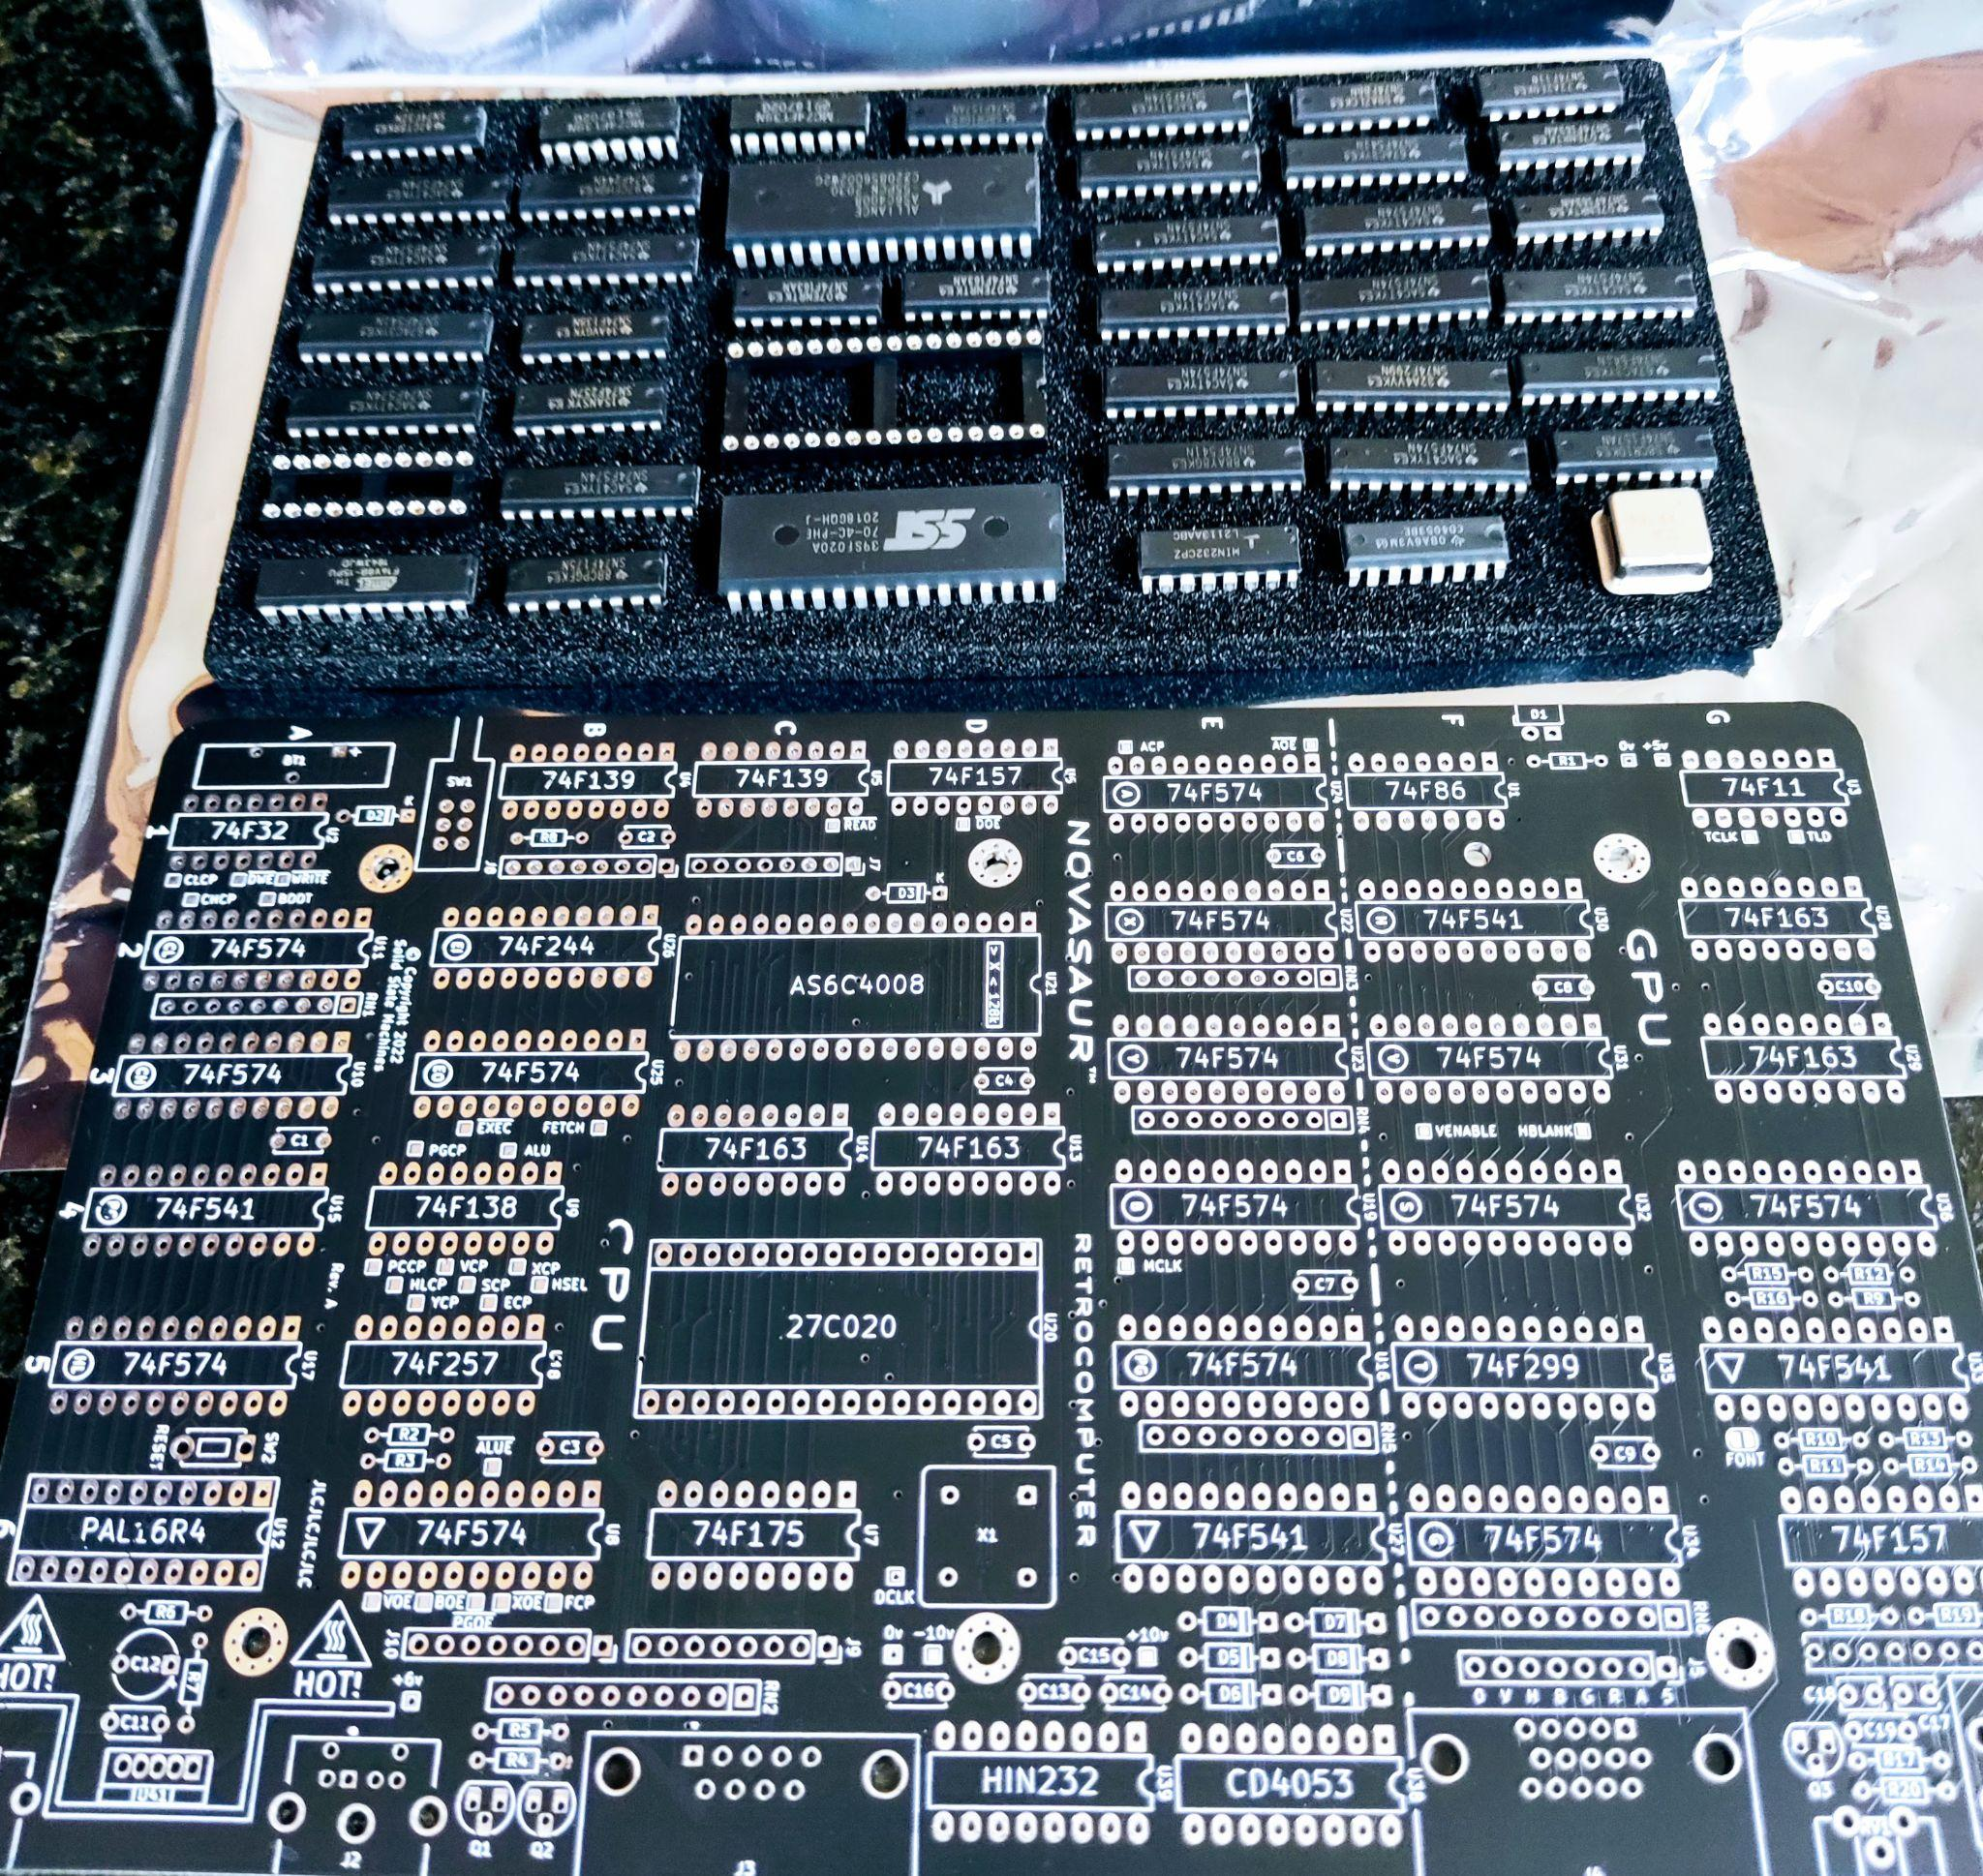
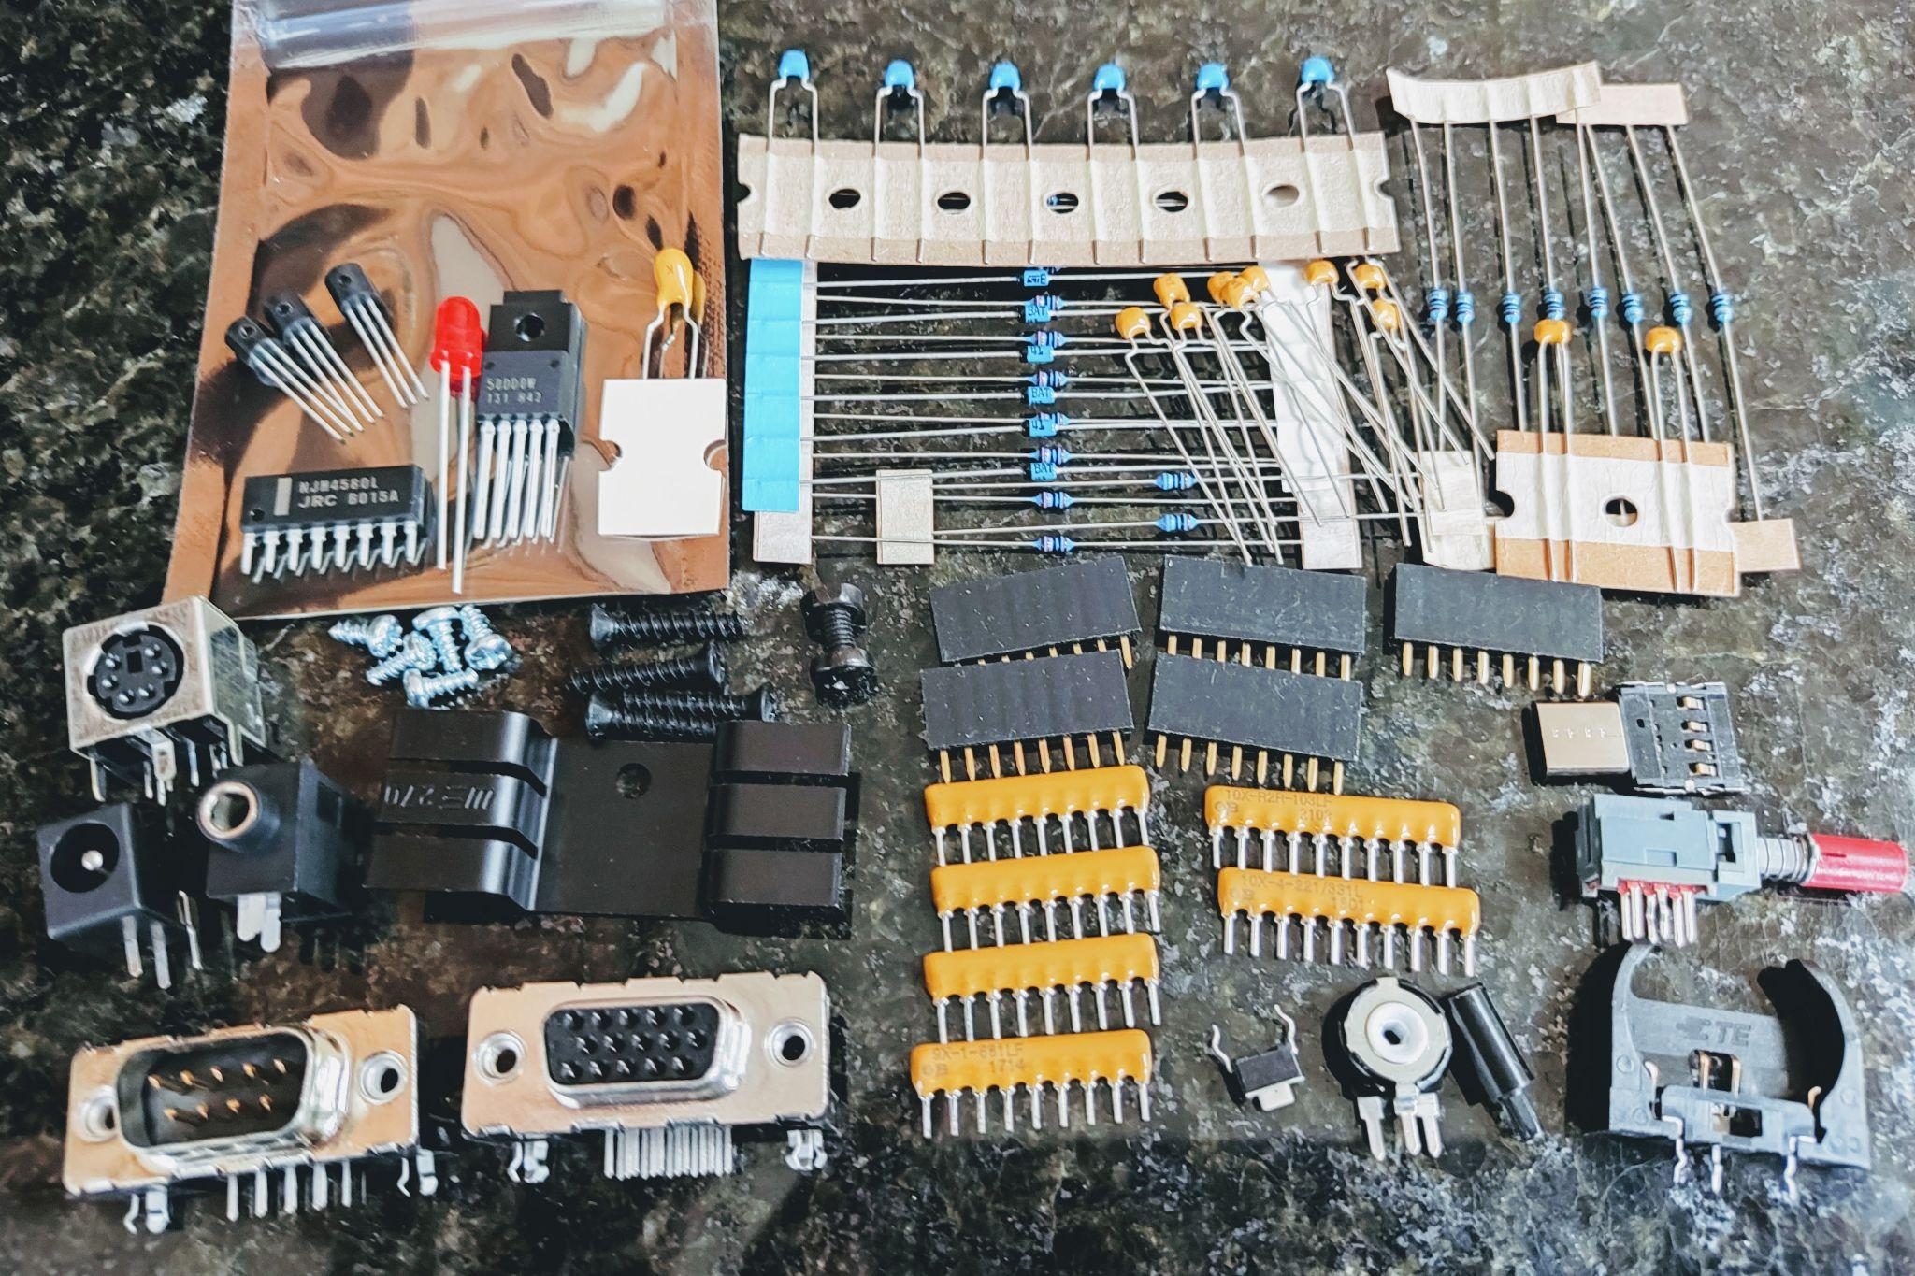
Novasaur Kit
MAY 2025
Notes:
So yeah, that's what the kit will look like and it's coming [May 2025], and yeah this
is the actual thing. So I'm going to go down [the stage] there and I'll power it up, if
you want to see it and see it do stuff.

Slide 48

Thank You!
VCF East
https://www.solidstatemachines.com
https://hackaday.io/project/164212-
novasaur-cpm-ttl-retrocomputer
https://github.com/ajhewitt/novasaur
VCF East 2023
Notes:
Thank You! and um, Yep thank you. [applause]
[PS from Alastair: The code discussed can be found here:
cold/warm start - https://github.com/ajhewitt/novasaur/tree/master/src/sys
bootstrap - https://github.com/ajhewitt/novasaur/blob/master/src/os/boot.asm
I basically wrapped up the software with the production version (1.1) at the beginning
of November 2024. I've created a release with the ROM image that you can download here - https://github.com/ajhewitt/novasaur/releases/tag/R1.1 ]
[See the text file of the presentation for Q&A afterward. Alastair describes more about the
SOT-23 prototyping effort. He mentions some RF emissions from the TTL prototypes. The kits
will come with programmed ROM which includes some CP/M software. An I/O expansion is mentioned. – Herb]

