Slide 1

Novasaur TTL Retrocomputer
Building a Computer
From Scratch
VCF East 2023
Notes:
https://www.youtube.com/watch?v=J4ykbJM90S0
Novasaur TTL Retrocomputer
Building a Computer from Scratch
– Alastair Hewitt
presentation, VCF-East Apr 14 2023
[text from YouTube captioning, edited by Herb Johnson Mar 2024]
Intro
We're gonna be introducing Alistair, who is going to discuss the Novosaur TTL computer. It's been great [progress] building this beautiful TTL logic computer, inspired by some other designs that have been out in the community. Without further ado, let him begin!
[Applause] So hopefully you can hear me? So I'm going to work off this screen. So hopefully it'll it'll work out.

Slide 2

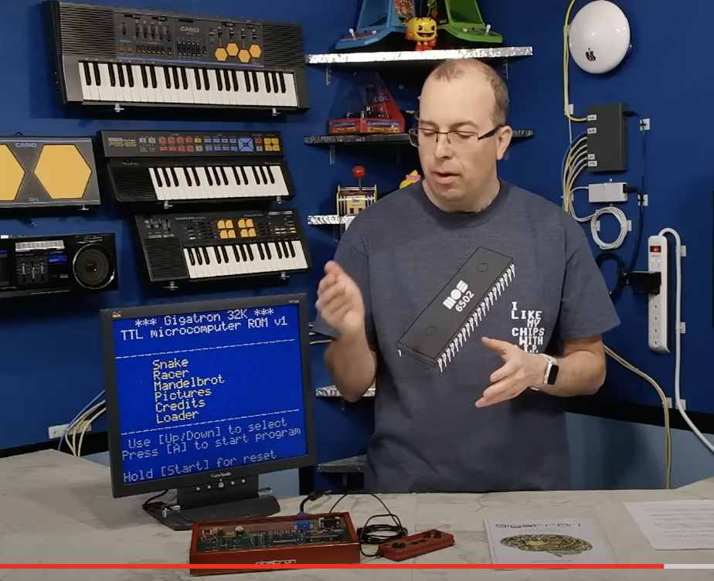
40 Years in the Making
1979 - First logic circuit (half adder)
1983/4 - Original CPU design
1986 - Digital Systems Engineering
1991 - Production Engineering
2018 - Gigatron release
2019 - Novasaur begins
Notes:
This is about the Novasaur TTL computer. This is a computer built from scratch. You may be familiar with the Gigatron? so this is a very similar thing. It's been about 40 years in the making. This [image] is me, that's actually I think it was 1980 I was 12.
My first ever logic circuit was I built a half adder out of a couple of switches, and that was in 1979. That was probably the first time I ever built anything out of digital electronics. I was interested in electronics as a kid and then I sort of had a zx81 and Commodore 64 and all this kind of stuff. But I always liked the idea of building my own computer. I was interested in sort of logic gates.
This design for [The] Novasaur really began in about 83, 84 and it was over that summer when I was at school. I sort of sketched out a couple of designs and that was essentially the genesis of this project. I went on to college to do digital systems engineering, which I thought it would be like electronic engineering but yeah without the calculus? But it was a lot of calculus as well.
I started in electronics and then around about 1991 I actually shifted more into production engineering. So instead of Designing Electronics actually I was developing production systems, test systems for the circuit boards. Then I went into more software testing and then intellectual software development. so that was pretty much the end of my electronics, around about sort of 91.
Until this [Gigatron] guy comes along. The Gigatron was released in I think 2018 and then there's the infamous Dave Murray video where he kind of talks about his dream computer. and that's the Genesis of the x-16. this is also the Genesis of the Phoenix products as well. it was also the thing that reminded me of this initial design that I had back in the 80s. I saw that video about and a year after it came out so I began in 2019.

Slide 3
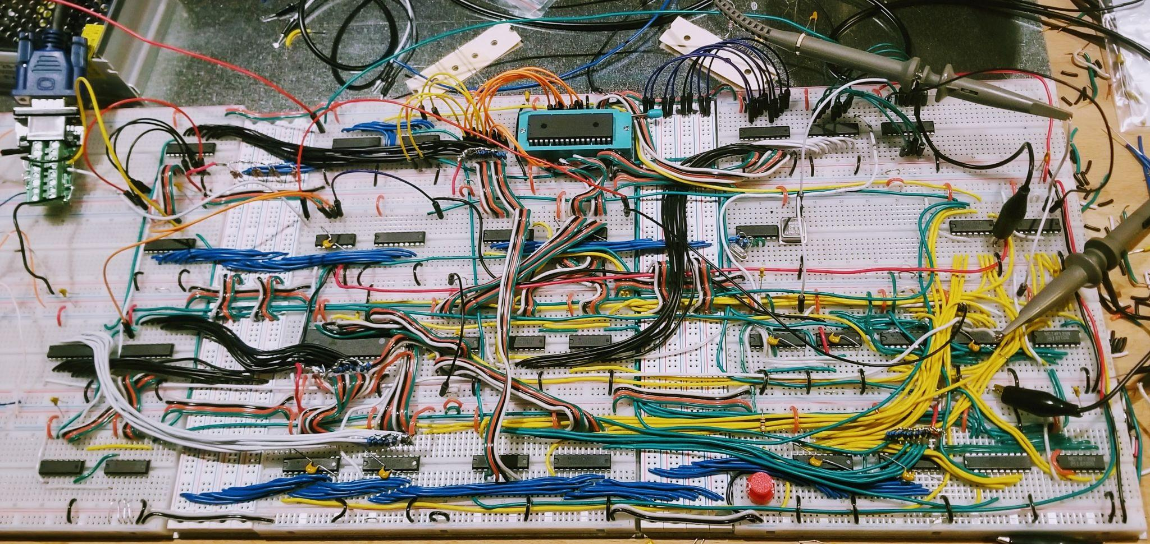
Novasaur Rev ‘0’
Notes:
Yes it's been about four years. That [image of a breadboarded computer] I would call the Rev Zero board. I did a lot of prototyping initially. just testing the pieces and this was the first actual working version of this thing. That was about six months into the project. So we're four years now. The rest of the time's just been software development.

Slide 4
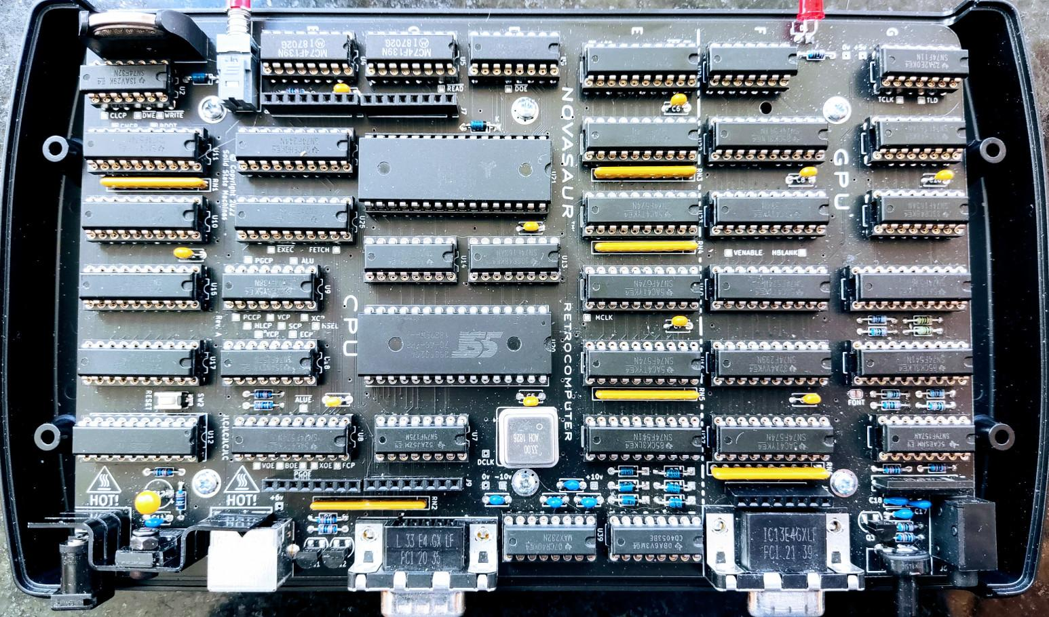
Novasaur Rev ‘A’
Notes:
This is the Rev A board. When I say A, I'm counting in HEX so this is the tenth revision. That's was pretty much about two years ago that was finished. It's [since] been a lot of software.

Slide 5
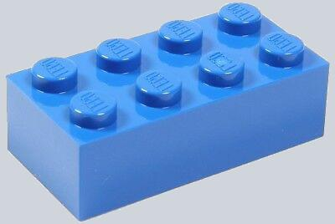
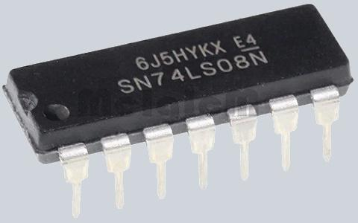
Hardware Requirements
Simple building blocks
1970’s technology - exists EOY 1979
Readily available - 50+ years later?
74-series TTL chips - not CMOS
Scorched-earth minimalism
Fast enough to be useful
Notes:
So the hardware requirements for this were. basically, I wanted to build something with just basic building blocks, the simplest building blocks [of TTL]. I wanted to stick with the 70s technology because when I was first working on this, that was kind of what was available. This was then the early 80s but I wanted to stick with that, so no kind of FPGAs or anything. I just want to keep to that sort of a time frame. It has to exist at the end of 1979.
it also has to be readily available today 50 years later. So this is like, if you're in the 80s trying to find a 1930s vacuum tube. but there's a lot of 50 year old technology still available.
That's the TTL chips. 74 F-series TTL. I'm not using CMOS so I actually want to use TTL which uses a lot more power. It kind of adds a another layer of pain to the project.
Scorched Earth minimalism - This is always the thing I wanted to do when I was building this. Just the minimum amount of stuff, not quite getting to the Turing target. just the most basic thing but still be fast enough to be useful. Something that can be programmed and can actually do something. The thing I worked on back in the 80s, that was like a really simple thing, that would have a couple of buttons and some LEDs. Or maybe it could print, like, prime numbers or something but that's about it. But [for] this one I wanted to actually do something useful and be a usable thing.

Slide 6
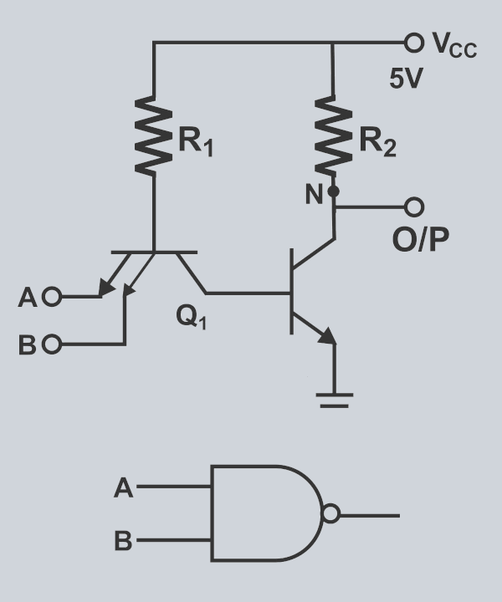
Technology
TRANSISTOR-TRANSISTOR LOGIC
POWER
mW
S
H
20
ADVANCED SCHOTTKY
SCHOTTKY
10
AS
F
ALS
LS
L
0
1
3
10
30
SPEED
ns

Slide 7
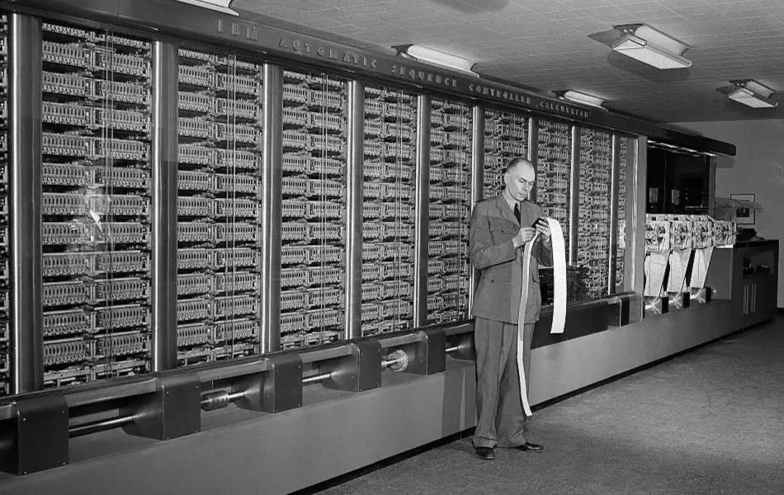
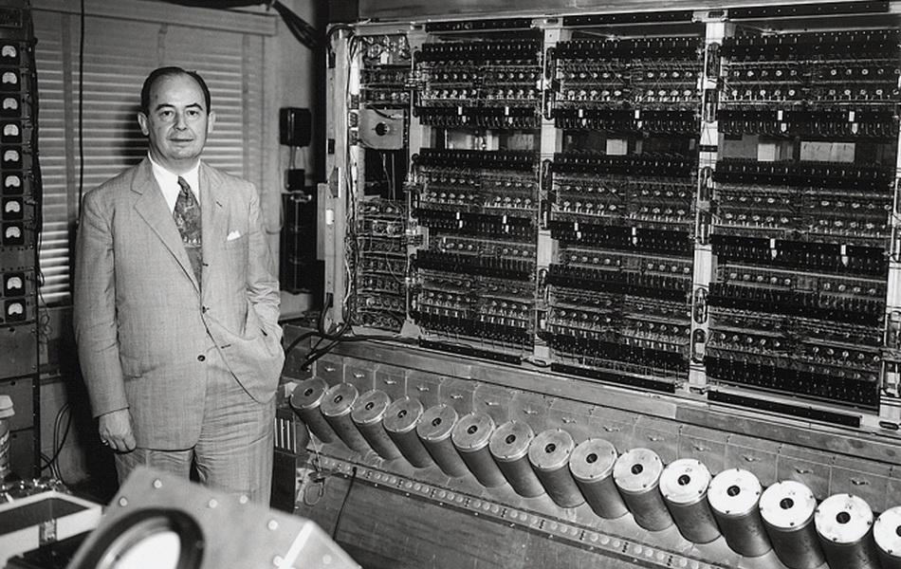
Computer Architectures
Harvard
von Neumann
Harvard Mark 1
Punch tape is the program memory
EDVAC
Stored program (loaded from tape)
Notes:
So there's basically two computer architectures: there's a Harvard and a Von Neumann. You might be familiar with this. I think this guy is Howard Aiken. He was responsible for building a very early mechanical computer. You can actually still see that see this in Harvard. it's named after Harvard not [Aiken].
The other guy [von Neumann] was a bit more famous. [in the image] that's the EDVAC. So von Neumann wrote a paper, and this was the first implementation of that [paper]. This is a stored program computer. So the program would come on a paper tape, and it'd be loaded into the memory. Then the computer is actually running the program from its memory.
[On] the Harvard Mark One, the punch tape is the program. So if you want to create a program Loop, you take the punch tape, connect it together. Then it actually reads the tape directly. And then you have subroutines which would be a separate tape.

Slide 8
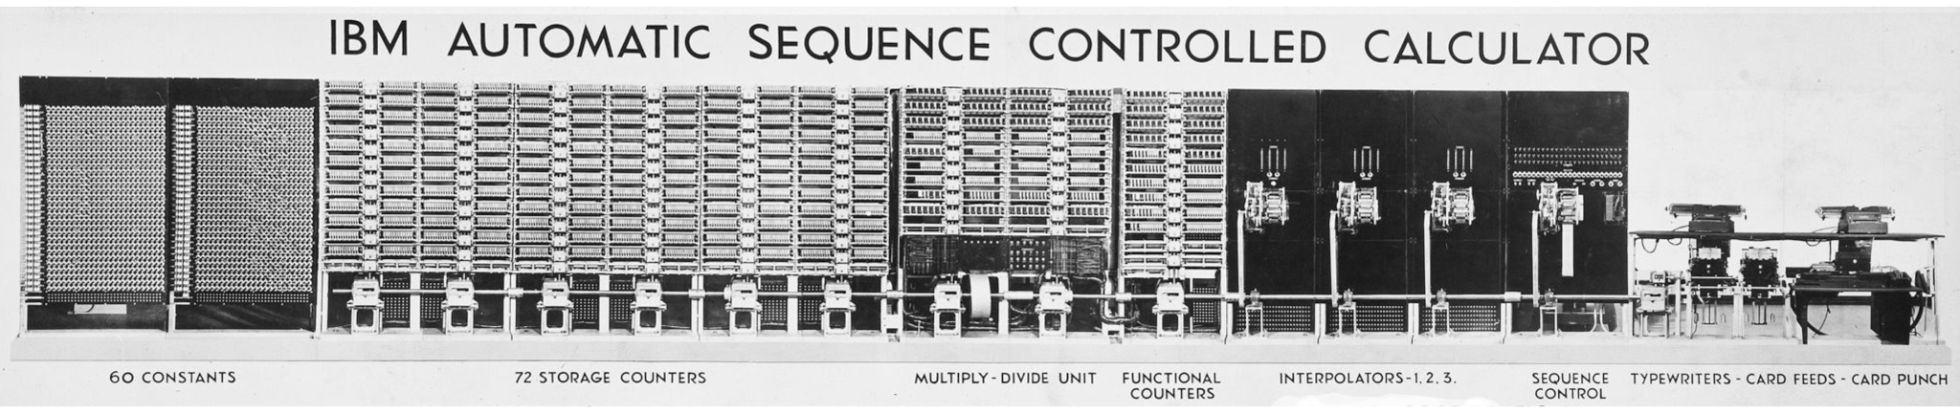
Harvard Mark 1
Data Memory
Program Memory
Storage Counters
(23 decimal digits)
Paper Tape
(24 bit instructions)
Notes:
So that's that [the Harvard] machine there [in the image]. It has a data memory and I think it's 23 decimal digits. This was used for a lot of scientific Computing and defense oriented things. The program memory [had] 24-bit instructions on a paper tape read by the machine as it's executing the code.
The important thing about [the Harvard], is [that] there's two separate memories. these are completely separate. With the Von Neumann architecture you have a single memory, that has program and data in it. But with [the Harvard] they're completely separate, and that's what I'm doing here [with the Novasaur].

Slide 9
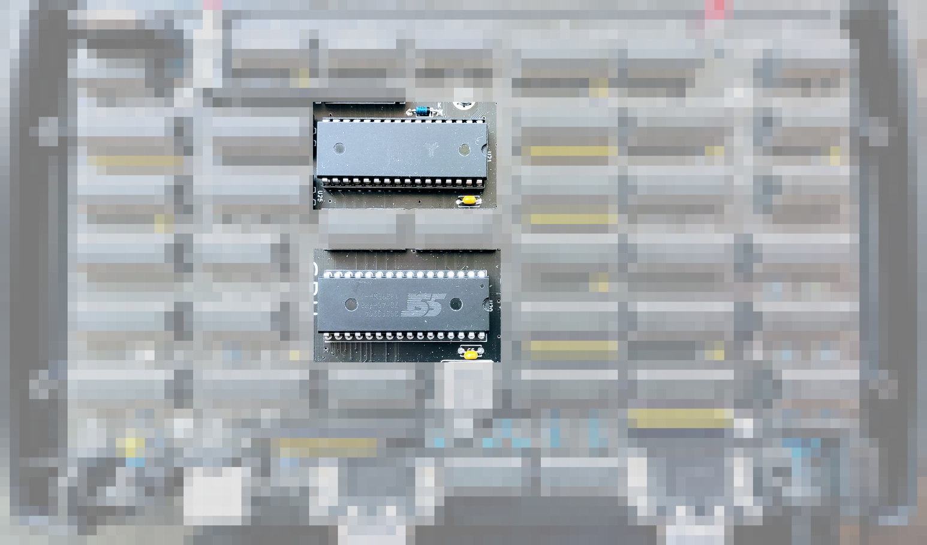
Harvard Architecture
Data Memory
Program Memory
Notes:
There's two memory chips [in the Novasaur]. These aren't 1970s technology; this is the one anachronism. These are sort of modern but not ridiculously [so]. These are still less than a megabyte. You could potentially get these memory chips in the 70s and you could basically build this [then], but it would be extremely expensive. You could probably buy a house for the same amount of money [then].
.

Slide 10
Harvard Architecture
ALU
Control
Unit
I/O
Program Memory
Data Memory
Notes:
[So] this is the Harvard architecture. There's an ALU control unit, I/O and then there's the two separate memories. The program memory is typically going to be read only although potentially it could update that. This is a fixed like immutable thing, if you want to change it you have to physically change [the chip]. Then the data memory, you can read and write to.

Slide 11
Simple Addressing
Page
PC
ALU
X
Y
Control
Unit
-8 bit
-8 bit
Program Memory
|
8
bit
Data Memory
8-bit page register
Single 8-bit counter
No address bus needed
*one index per memory
8-bit X register
8-bit Y register
Notes:
You might think, well, this looks more complicated than it needs to be. But it allows you to do a very simple kind of addressing. This is what I learned about the Harvard architecture, at some point in 83 I think, I can't remember where. But when I learned about it, I'm like, that's really easy to make a computer [with]. Because you don't actually need an address bus for this, [unless you] only have a single index register.
I'm doing 16-bit addressing but rather than having a 16-bit program counter, I'm actually using a page register which is eight bits; and then an 8-bit program counter. So the program counter, it takes a couple of chips - they're typically four bits - and then a buffer. but if you had 16 bits, that's four counters.
So keeping it really simple, I have a single 8-bit program counter. Then if I have to go beyond the [8-bit] page. I have to jump to a new page. that resets the program counter back to the beginning. Then it will start to execute code in the next page. That does cause some fragmentation of the memory, of the actual program. But we've actually got a decent amount to work with in terms of memory.
So [there's] a single 8-bit page register, a single 8-bit counter, and then there's the X and Y index registers for the memory. So there's just a single X and Y index. That's kind of like the 6502. So you don't have to swap [them] around.

Slide 12
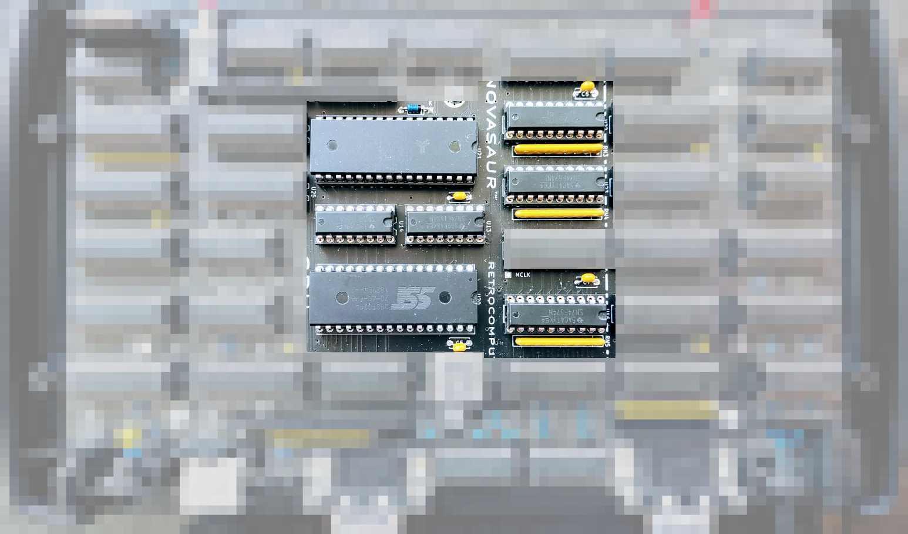
CPU Addressing
X Register Y Register
Program Counter
Page Register
Notes:
That [image shows] where all those chips live on the board. There's the two memories there's those two program counters, four bits. Then there's a page register, and then the XY register.
You might notice these [10K] resistor networks. They pull high. you can actually default any of these addresses to FF just by not turning them on. that's used with the page register. so during boot it just doesn't turn on the page register, and it goes to FF. And that's where the boot code starts.
then there's also a zero page, we'll get into later. That's done the same way by pulling it to FF, instead of pulling it down to zero. This is like a really cheap way of doing that.

Slide 13
Minimal ‘Toy’ Computer
Instructions are represented as a Control Word
The Control Word defines:
  A data Source - program or data memory
  An ALU operation to perform - add A or 0
  A Destination - any register and/or data memory
Every instruction is an ALU operation
Every register takes its input from the ALU
Notes:
We're going to sort of go through a minimal toy computer; which is actually not far off from what [the Novasaur] is. So we're going to load the instructions and then store them as a control word. I did have an instruction register, but it's not actually the instructions [that] are really telling the machine what to do, as opposed to a microcoded instruction which has to be decoded. this has all the information the machine needs to do something without very minimal decoding. and so that control word is going to define a source.
In this simple example, we're going to use either the program memory or the data memory as our source. Then there's going to be an ALU operation to perform. in this example, we're just going to add the accumulator; or we're going to add zero. Then the destination register is where the result goes. we can specify any of our registers.
So we can actually send that to the program counter to do a program jump. And, we can also specify the data memory. So we can read something for data memory, we can update it, and then write it back. Every single instruction or control word is specifying exactly the same thing, just which particular flavor.
So that means every instruction is an ALU operation ,and every register essentially takes its input from the ALU. So yeah, you go to every register and then you decide based on your control word which one you're going to load. And so that's our computer.

Slide 14
Does it Work?
Page
PC
ALU
X
Y
CW
A
Program Memory
Data Memory
Notes:
So does it work? Well, [in] the program memory we're going to do a Fetch and it goes into our control word. And then we're going to have a input, either from the program or data memory. Then the result goes to the accumulator, or it goes to one of the other registers. If it's in the accumulator we can write it back to the memory. Technically this kind of does work, and it's not from a concept, this is sort of what's going on with the Novasaur. But you might notice some things about this.
Let's say we wanted to write a program which is going to scan through the memory, and it's going to read bytes, [but] we can only write to the X register. Let's say we want to read from the X register, update it, and write it back, like have an X increment.

Slide 15
Can it Increment the X Register?
Assume the value is saved in memory address [33, 55]
X = 55 + 0 # set X index of stored value
Y = 33 + 0 # set Y index of stored value
A = 1 + 0 # set up an increment function
A = [Y, X] + A # increment stored value
A → [Y, X] # update stored value
X = 0 + A # set X with incremented value
Notes:
So can we even do that? Well, this is where you have to use the memory to actually store your x value. Because we want to read that and we only have this very simple structure. So we're just going to put it in a location and I just chose this [address] 3355. That's the Y register with three three, and the X register would be five five.
To load the X register with our index to get the X register, we have to use an ALU operation. We're going to load 55 from the program memory. We're going to have to add something to it. So this is where we had this add zero operation, that's kind of an identity function. We do the Y register, and then we want to do an increment. There isn't an increment instruction. So we're going to just load a one. We have to go through the ALU to get to the accumulator, so we can add zero to it.
Now we can actually do our increments. So now the accumulator is going to take its input from the data memory, using that X Y index. It's going to add the accumulator which is one. Then it's going to write that back, because it's got to remember the results. Then finally we can update our X register.
And that's basically how it's going to load a zero from the program memory, and then adding the accumulator which has our results in it, and then we've updated our X register. Now we can do what we want to do with our X register. Then we've got to go through this whole process again, to increment it to the next instruction.

Slide 16
Can it be Improved?
Assume the value is saved in memory address [33, FF]
X = 55 + 0 # use a “zero page”
Y = 33 + 0 # set Y index of stored value
A = 1 + 0 # set up an increment function
A = [Y, X] + A
A → [Y, X] # combine as [Y, FF],X = [Y, FF]+A
X = 0 + A
Notes:
It can be improved. so you can use a zero page. The zero page isn't "Y equals zero", which is normally what it would be. it's actually "X equals FF". Instead of being the first page of the bank one of the memory, it actually uses the very last column.
We still have to specify where we're storing this X register value. So we have to still load Y. we still actually have to do this thing with the increments, where you have to load the accumulator with a function to increment. And then because we're not actually using the X register, we can update it now. So this last operation is essentially going to take the memory, add the one, and then write it back to the memory and update the X register - all in one go. So those three steps are combined.
[While] that still looks pretty ugly, that's actually basically exactly what it's doing. I've got code which I actually pulled from the machine, which is doing this, with those three steps. We'll take a look at that in a bit.

Slide 17
Can it get Smaller?
Page
PC
ALU
X
Y
CW
A
Program Memory
Data Memory
Lookup Table
Notes:
But can it get even smaller? So this is another thing: back in the 80s, I was really interested in actually taking the ALU and then putting it in that program memory. Not to having a separate chip, but a single chip, so one bank would be your program, and another bank would have a lookup table to perform the ALU operations. So we had a very very simple machine which had to have an ALU. [but] now it's even simpler.
But in order to make this work, you actually now have to start adding some complexity back, there's a bit more states you have to deal with.

Slide 18
Lookup Table Options
Fn
Fn
Fn
4x4-bit addr
Pro - small
Con - complex
2 cycles, carry, intermediate result register
8x4-bit addr
Trade off
2 cycles, no carry, A is intermediate,
8k per function
8x8-bit addr
Pro - simple
Con - large
64k per function
Notes:
It's basically some different options by doing a lookup table. The simplest one is like an eight by eight address space, so 64 K of memory. You put one 8-bit value on say the lower eight bits, one eight bit value on the upper eight bits. Then you get a result of eight bits coming out of this thing but that's 64k per operation, which is kind of expensive. Especially back in the 80s that was a 64k ROM just to do one operation, [it] wasn't really feasible, so you can kind of halve this. This is actually what I think what the z80 does, where you have a 4x4 well, that's basically a four bit ALU. And so this is much much smaller, this is only 256 bytes per operation.
But it's very complex, because you have to do two cycles. You have to basically take a carry, and then there's an intermediate result register which has to shift things around. So it gets it gets very complicated, But there is kind of a trade-off. You can actually just treat one of the bytes directly.
So the accumulator goes in as an 8-bit value, and then the other input is split into two. So what I do is add the first half using a 4K table. The result goes back to the accumulator, and then you recycle it to do the second path. You actually have to have a different table to do that, because you have to take into consideration you're shifting up by four.

Slide 19
Example 8x4 Table Addition
2
9
5
8
8
3
1
5
8
1
A =
HL =
+L
Lookup 1 :
A = A + L
+H<<4
Lookup 2 :
A = A + H<<4
Notes:
Here is a quick example. So you have the accumulator has say, 29 hex. Then I have an HL register, so the other half of this is in a register [in] which can you can switch the nibbles. So you can either take either the L or the H nibbles, not bytes. You're going to add the eights. So that 4K lookup table basically gives you that initial result. Then you just kind of recycle that and do another operation, using a different table, which treats the next nibble as if it was shifted up by four. Then you get to this eight-bit result.
That's actually not too complicated to do, so it's a good trade-off. So in that 64k of memory of ROM, I can actually put eight operations. But it still does that two cycle [process].

Slide 20
ALU Addressing
HL
B
X
Y
CW
A
-4 bit
-8 bit
Program Memory
as
ALU
|
4
bit
Data Memory
Notes:
So that's what the addressing looks like for the ALU. There's [also] this B register, which is really just taking a copy of the ALU. we're going to update a copy of the A accumulator. It's going to go into B, and then B is used as addressing when we go to update the accumulator. So you have to add this pipelining. The HL is four bits [each] and then that gets switched [as described before]. Then your control word actually specifies one of 16 operations that can be performed. That's kind of not too far removed, and it's not too much additional complexity.

Slide 21
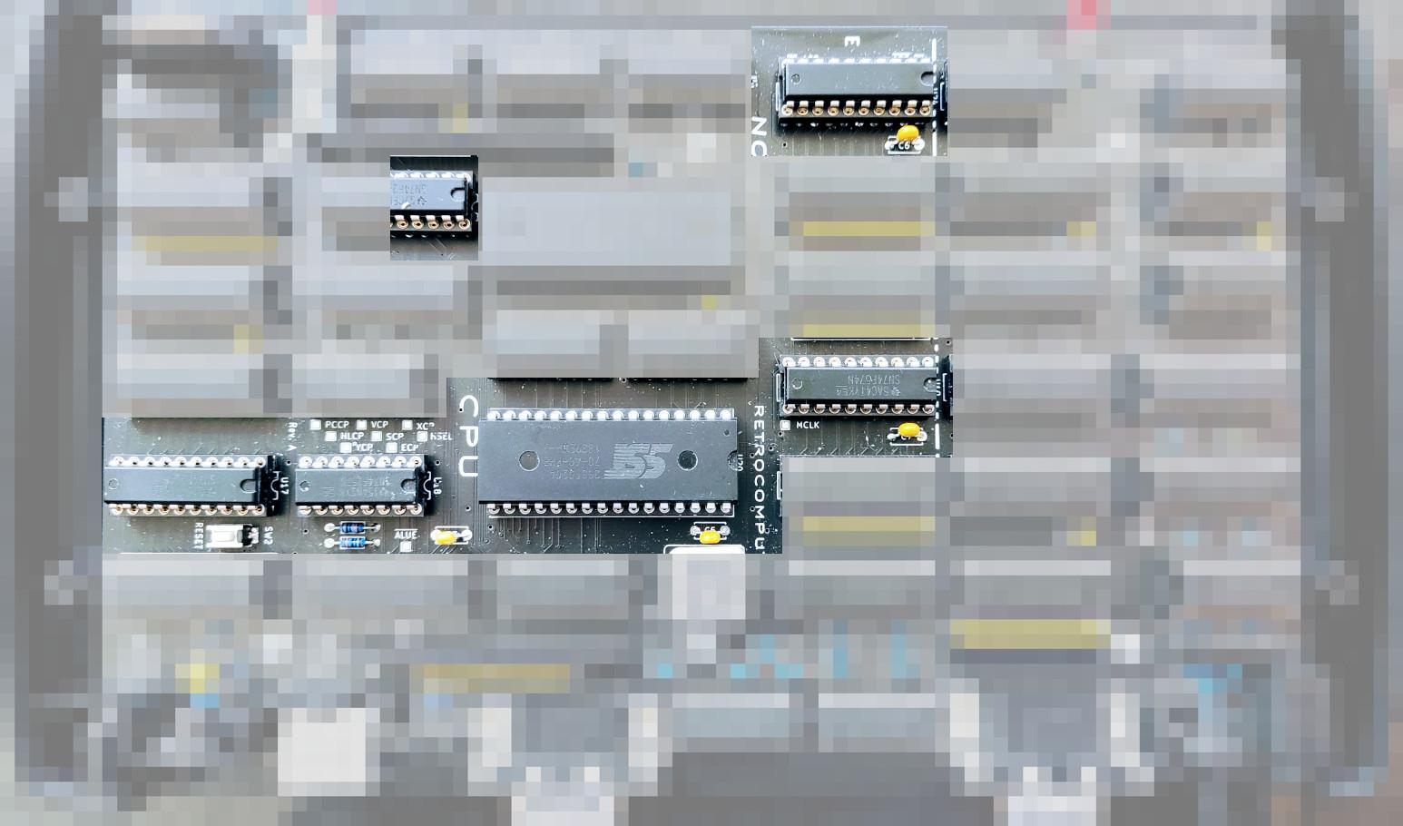
ALU Addressing
A Register
ALU Func
B Register
HL Reg
HL Sel
Notes:
That's where all that ALU kind of addressing lives. There's an accumulator that's the A register, the pipeline is a B [register]. Then the HL register is a basically an 8-bit register; but then there's this selector which selects one of the two nibbles. Then the ALU function comes through half of this chip - those are the four bits [of it].

Slide 22
ALU Functions
40
MV - move HL to dest
ADD - addition (no carry)
AF - arithmetic flags
AND - logical AND
OR - logical OR
XOR - logical XOR
WAV - wave table
DIS - dispatch page
MUL - multiply (8=4*4 bits)
DIV - divide (4=8/4 bits)
COM - comms state
VID - video timing
FNC - unary functions
FND - unary (8080)
FNE - unary (VM)
FNF - unary (default)
Notes:
So these are the ALU functions you get:
MV - So I have a MOVE operation which doesn't really do anything so print. Remember, everything has to go through the ALU. so this is basically just taking the H and the L, and then moving them to whatever the destination is going to be.
ADD - There's an add, but there's a problem with this, because we're using this memory with an 8-bit output. if you add two 8-bit values together, you get a nine bit [result] because there's a carry. So we only have eight bits. Instead of having a subtract next, which have this ??, so you can do a two's complement addition. You don't have to waste a whole table to do subtract.
AF - This next one is actually I call arithmetic flags, and it gives you another eight bits. so what you can do, is [that] you can do your add. Then you follow that add by this AF function. That gives you another eight bits of flags. You get a carry, overflow, sign, zero flag, and it also gives you the borrow Flags if you're doing a two complement addition.
[AND OR XOR are] three more classic [operations].
WAV, DIS - Then another thing about doing this kind of ALU in the ROM, is you can pre-calculate all sorts of kind of crazy functions. So I have a wave table in here which is used for the kind of audio system. Then this [dispatch] thing is used, sort of like a virtual machine, we're going to get into. But that is how it determines which page it's going to jump to next, based on its current state.
MUL, DIV - There's a multiply and divide, but it's really just nibble wide. So the multiply is really like multiplying two nibbles together and giving a eight bit result. The divide is taking an 8-bit value and then dividing it by a nibble to give you a nibble. So that fits very neatly in that eight by four structure.
COM, VID - [there's] a couple more specialized ones. There's a state machine used to sample the actual serial state. That's another sort of specialized table. Then the video timing tables live [over] here.
FNC - Then you're into the unary functions (unary functions I can never say that). So a unary function is like increment or decrement. So these are those are binary. in the sense you have A plus B, this is instead "do something to A". So each one of these is [one of] 16 unary functions.
FNC, FND, FNE, FNF - There's actually 64 of these, a lot of specialized ones. This last one, is like the default set, that's got sort of all the classics like increment decrement. so there's actually 64 there plus these 12. The very last one, is a kind of specialized Hardware one. So I'd say all together there's 75 operations supported by the ALU.

Slide 23
Default Unary Functions
IDEN A = A
INC A = A + 1
INC2 A = A + 2
DEC A = A - 1
1COM A = !A
2COM A = -A
LSR A = A >> 1
LSL A = A << 1
ZERO? A==0?
KERN? bank==1?
INCLINE inc VM line
INCBLK inc VM block
NSR A>>1 | 0x80
SWAP AB = BA
REVERSE reverse bits
AUDIO flip sign
Notes:
These are default [unary functions].
IDEN - The first one's the identity function.
INC, INC2, DEC - increment [one], increment two (so it adds two). So this is basically adds zero one or two decrements.
1COM, 2COM - One's complement set inverts the bits, two's complement [is] inverse plus one. So that gives you the negation.
LSR, LSL - A logical shift right, logical shift left.
[several] - and then there's a few specialized ones which are very commonly used. This one's quite handy though. This operation takes the accumulator and it returns a zero if it's zero or it's minus one.?? I can do conditional jumping based on the sign of the accumulator. so if I'm going to figure out if the accumulator is zero I can do this and then jump on the sign. So basically, if the sign is a positive result it's zero, if it's negative it's not zero. Then these are some other things: swap nibbles, stuff like that.

Slide 24

Execution State Machine
Generic Array Logic
(16R4 circa 1978)
Notes:
So, the actual control unit, I call it the Execution State machine. This is deciding what's happening on the various cycles. This is actually in a generic array logic [device]. It's configured as a 16R4 [PAL], which is about Circa 1978. so that is kind of era-appropriate. It soaks up a little bit of the logic. it's got four bits of State in it, and it tracks the boot - whether it's booting up or not. And it's got two bits for the execution.

Slide 25
Execution Sequence
FETCH
READ
EXECUTE
WRITE
Read control word from Program Memory
Decode
and
Read data from
Data Memory
Read ALU or immediate value from Program Memory
Write result to register and/or Data Memory
Single CPU cycle
x2
Notes:
On the execution sequence, it's as follows. We kind of went through it with that toy example. We do a fetch so we're fetching the control word: that's that first cycle. We do have to do some kind of decoding, so we need a bit of time to do that decode. But during that time, if we're going to use the memory we're reading the memory. We don't know whether we're going to use that yet; but we need time to actually access the memory. So together that's sort of fetch then read. It is a sort of one process [in two] cycles.
Then the ALU is another process cycle and that's the execute. We're reading the ALU or the immediate value from the program memory, if we're kind of loading a constant from the program. Then we're going to write the result back. So if we're going to update the memory we need time to do that. And if we're doing this sort of two-cycle ALU operation, we have to kind of do that twice so that's two of these CPU Cycles. you might notice that there's we're doing program - data - program - data.

Slide 26
Memory Concurrency
FETCH
READ
EXECUTE
WRITE
ROM
RAM
ROM
RAM
READ
LOOKUP
READ
N/A
RAM
ROM
RAM
ROM
Notes:
And so because we have the Harvard architecture, when we're using the ROM the RAM is kind of idle, and vice versa. Basically all of [ROM and RAM are] kind of up for grabs. So, whilst we're fetching something from the ROM, like doing our program fetch; something else could read the RAM memory. We could look up something in the ROM when the CPU is using the memory, go back and read, and then maybe you don't want to do anything. so it's like another set of cycles available.

Slide 27
Introducing the ‘’ GPU ’’
Transparent DMA - read RAM while CPU reads ROM
Add Horizontal counter and Vertical index register
Graphics Mode - one byte per pixel (256 colors)
Text Mode - two bytes per char (ASCII, 8 colors)
  Read character code point from RAM
  Lookup glyph data in ROM → shift register
  Read FG/BG/Font value from RAM
Notes:
[And] so we can add a second processor. We could actually add a second CPU to this and have it run concurrently. I call this a GPU but it really isn't a GPU in that kind of modern sense.
Transparent DMA - It's a transparent DMA controller, transparent because it doesn't stop the CPU to access a memory. It's just running concurrently on these off Cycles. It can read the RAM whilst the CPU is reading the ROM. So that allows us to have a video memory that we can now scan without interrupting the CPU at all. And the CPU can update that memory. [You can] get these sort of very simple computers that have dual Port RAMS. But this is another way of doing it.
Horiz, Vert - So in order to use a video memory, we have to add another index. [Thus] we have the XY RAM index. And we're going to add a horizontal and vertical index register. The horizontal is actually a free running counter, kind of like the program counter, but it's not, it's running continuously.
Graphics Mode - Then we can support a graphics mode where we're going to read one byte from the memory and output as a pixel. We just put the output through some resistors to generate 256 colors.
Text mode - But another thing about this, and this is the really the important reason for doing this, is [that] we can build a native text mode, because we have that ROM available. So we can read a code point, like an ASCII value from the RAM. We can then look up glyph data in the ROM, and then load a shift register [with that]. Then that can get clocked very very [fast], like eight times the [cycle] speed. That generates a native text mode, and then we we load a color value as well. That provides a foreground background which is going to switch between.
So what that GPU is doing, is basically loading that ASCII [value], looking up what it would look like, and then using those bits to switch the colors to render that actual text [glyph]. That's what the GPU addressing looks like.

Slide 28
GPU Addressing
S
B
H
V
G
F
-5 bit
-8 bit
Program Memory
as
FONT
|
2 bit
BANK 0 as
Video Memory
Notes:
There's actually 32k that's used. There's a thing I call the scan register. This is updated by the CPU but it's reading the fonts glyph lines. So you can have eight by eight bit fonts, and there's also eight by 16. You need four bits - actually three bits for the other one, but I have another bit to select between the two. So I need five bits there. Eight bits for that B register. That pipeline is used by both [scan and B register?]. Then the output goes to this glyph register. Then we select the font using this F register [and] set loads of colors. There's also a couple of bits available in there, so that can select between these four different fonts.

Slide 29
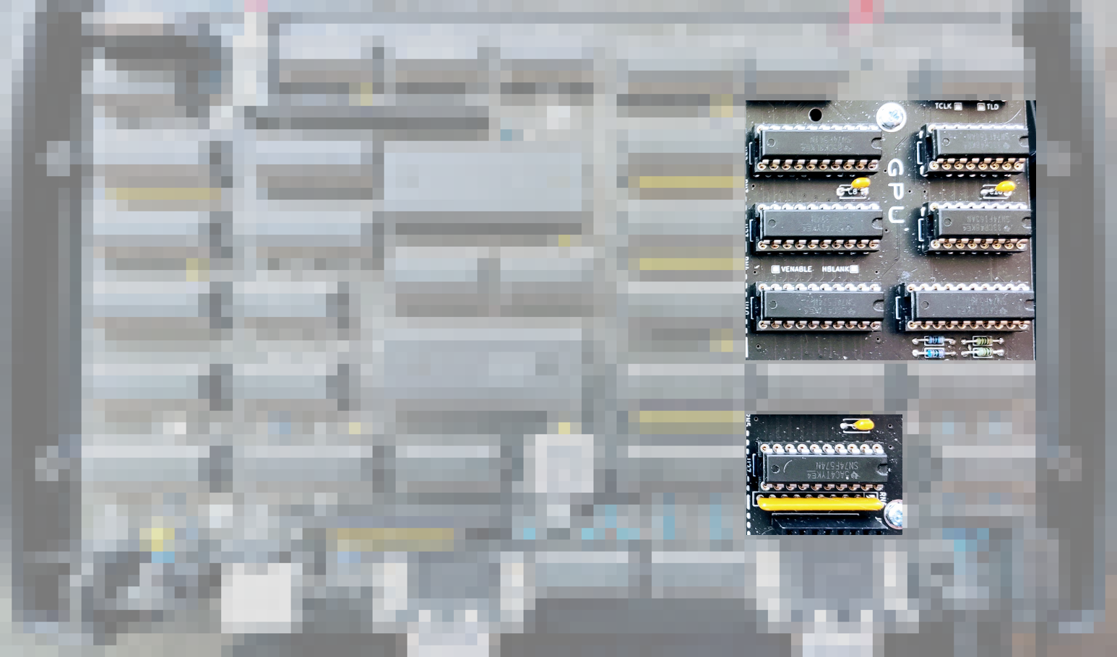
GPU Addressing
H Counter
V Register
S/F Register
G Register
Notes:
So don't worry too much about [the GPU], it's basically just almost like a simplified CPU. There's no program running on it, it's basically just each counter running continuously. Then the CPU has to update that V register and the SF registers live there. Then this G register.

Slide 30
256k ROM Memory Map
BANK 0
BANK 1
BANK 2
BANK 3
Program
64k
Storage
64k
ALU
high
ALU
low
Font
Notes:
So we'll cover quickly the ROM memory. This is what the actual ROM looks like. This [shows] all the stuff we have in the ROM. Bank zero contains the actual program that's being run. Bank one is used to store 8080 machine code. That could be read, sort of like the ALU, it's like another ALU. Then the ALU actually lives down here [in banks 2 and 3]. So we have our 16 operations, of which eight of them are these extended two cycle versions. Then the font lives there [in bank 2].

Slide 31
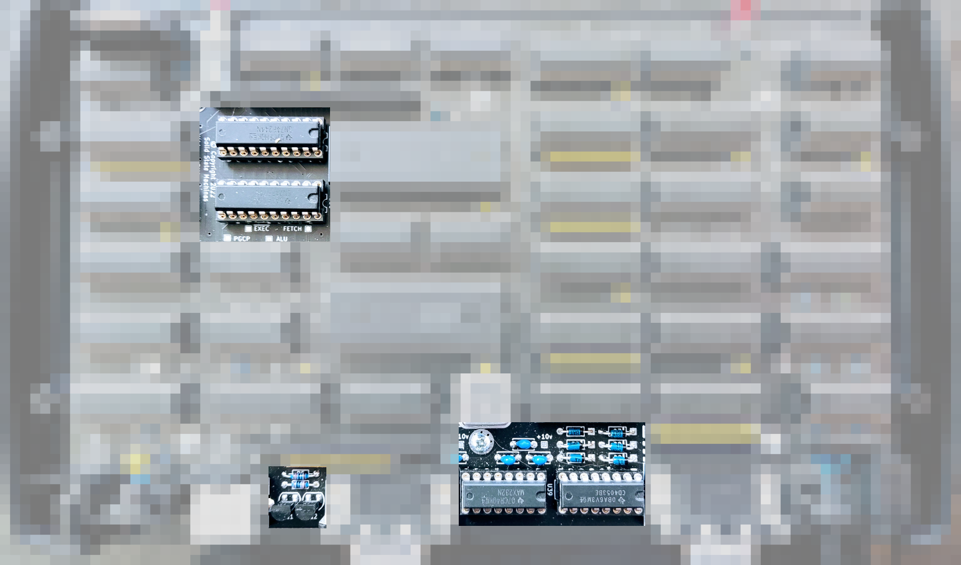
Input/Output
Ei Buffer
Eo Register
Line Driver
Analog Switch
Notes:
We haven't talked about the input output! So we have to bit bang everything. So there's a couple of registers. One is used to read and the other ones are used to write. So there's bits that are coming in, bits that are going out. We have a line driver and analog switch, to select between the two video modes. And there's a couple of transistors for controlling the keyboard. And that's where those [bits] live.

Slide 32
Ei/Eo Register
KB CLK
KB
RX
CTS
RX
expansion
VID MODE
KB
EN
RTS
TX
RAM BANK
30
7 6 5 4 3 2 1 0
INPUT
7 6 5 4 3 2 1 0
OUTPUT
Notes:
This is what the EI and EO register looks like. So there's two bits of the keyboard, two bits for the RTS CTS flow control. I need these four bits on input. On the output there's three bits that are used for the actual select between eight Banks of RAM. There's two bits needed for the video because we have to select which video mode we're in, whether we're doing text. Then, which sort of video DAC we're selecting. We also have a bit where we can basically inhibit the keyboard to stop the keyboard scanning. the keyboard is scanned every 15 times a second so it's not continuously scanned.

Slide 33
512k RAM Memory Map
BANK 0
BANK 1
BANK 2
BANK 3
Video
60k
64k
64k
64k
64k
64k
64k
64k
System
BANK 4
BANK 5
BANK 6
BANK 7
Notes:
This is what the actual RAM looks like. Bank zero has the video in it. Then we have seven banks of 64k available. There's an area needed for some system stuff at the top of that bank zero.

Slide 34

Control Word
Control Word
Notes:
This is where the control word lives. There's actually two registers so it's not eight bits it's 16. There's a there's a set of instructions that can use one of those bytes.

Slide 35
Control Word
EXEC MODE
SRC
ZP
WR
DEST REG
ALU FUNCTION
SRC
ZB
1
MODE
SRC
ZP
WR
DEST
7 6 5 4 3 2 1 0
2-CYCLE FETCH
7 6 5 4 3 2 1 0
1-CYCLE FETCH
Notes:
So when the machine fetches instructions, typically there's two bytes needed. But if that most significant bit is a one then it will not load the second value. The way it does that is it just skips that cycle, and it tri-states the control word, the second byte. So that all gets pulled high, so everything on that bottom row gets pulled up, that all gets set to FF.
So there's selecting the default ALU operations. You only get four possible destinations, two possible sources. That block is four bits, there's 16 possible destinations. There's eight registers on board, and there's an option to add another eight possible registers on an expansion [board]. [There's] zero page, this is that WR bit sets whether it's going to write the results of the memory or not. And ZB is the Zero Bank, so you can only use Bank zero with this half-instruction.

Slide 36
Execution Modes
0 | 4-cycles | ALU | HL→A
1 | 3-cycles | ALU | L
2 | 3-cycles | ALU | H → A
3 | 3-cycles | ROM | H
4,5* | 1 or 2-cycles | LOAD | * conditional on A sign
6,7 | 2-cycles | FNF | H → A, H
Notes:
[Here's] just a quick rundown of these execution modes. So the first three bits in that control word specifies what it's going to be doing in terms of Cycles. So the full four Cycles loading, two fetch two execute that's zero [mode]. There's a couple three cycle ones where it just does single execution of the ALU. Then there's these last two, these are your shorter instructions. so there's one or two cycles to do this immediate load. So you can do a conditional jump in mode five, it looks at the sign. What it does actually skips the execute, just jumps over the next cycle. Then these are the defaults, the last one is the default ALU operation.

Slide 37
Increment the X Register
Code | Assembler | Description | Cycles
9433 | LD Y, 0x33 | Immediate load Y | 2
9510 | LD HL, 0x10 | Immediate load HL | 2
58FE | FNFH DZ, XD | [Y,FF] , X = FNF ( H , [Y, FF] ) | 3
6 Bytes |  | ~850ns @ 121ns/cycle | 7 Cycles
Notes:
So, I'll just show a quick example of what that looks like. This is incrementing the X register again. So this is actually what the code looks like. There's six bytes in order to do this example. We're doing our immediate load, doing our immediate HL. We're actually loading one into H. Then we're doing this FNFH operation, one in that default set of instructions is an increment, and then this is how we do that.
There's actually I think about 17,000 possible instructions or combinations of things you can do. There's 65 K [available] but of which about 17,000 are valid.

Slide 38
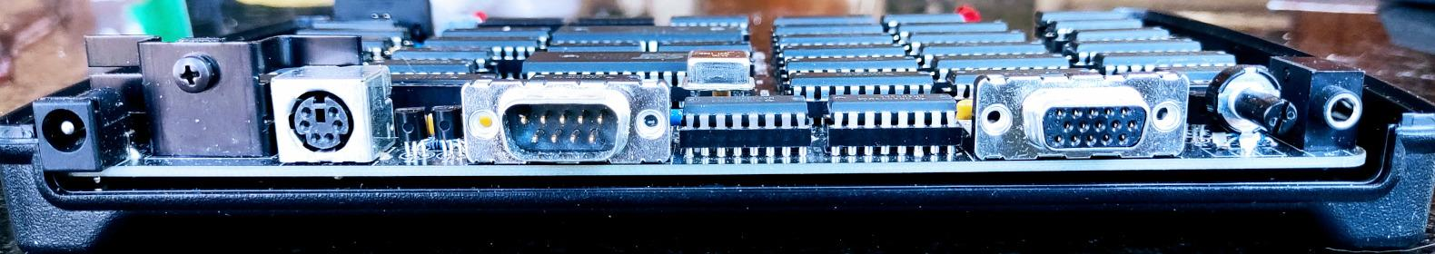
How does it actually work?
Keyboard
Serial
Video
Audio
PS/2
US/English
RS232
CTS/RTS
VGA, SVGA, XGA
60,75Hz Refresh
3 Voice, 1 Noise
ADSR
Notes:
So yeah, that's the CPU, it's super basic. [Then] we've got the keyboard interface, [and] serial interface, there's no UART. There's no like video chip, no VIP or SID chips or anything like that. So all of this has to be bit banged.

Slide 39
Software Requirements
Concurrent protocols - lots of state
Critical timing - lots of control
No Interrupts - protocols too fast to restart
Cannot Yield - no user program on hardware
Stored Program - user program → data memory
Interpreter - virtual CPU with existing ISA
Notes:
So the software requirements come like this. We have a lot of concurrent protocols so there's a lot of State. there's a lot of critical timings, there's a lot of control needed. We can't really interrupt it. We can't like, let's load a user's programs. start executing them, and interrupt it like 30 000 times a second to do video timing, that's just not practical. We can't yield to a user program. So we cannot run a user program actually on the hardware. We also want to store a program. We want to be able to load a program at runtime. So [the program] has to live in the data memory.
That means we need to have a basically a bytecode interpreter and a virtual machine or virtual CPU, preferably using an existing instruction set architecture.

Slide 40
Software Stack
Application
User Program
CP/M
BIOS
Micro Kernel
Disk
Timers
TTY
Console
Hardware Abstraction Layer
v8080 CPU
Hardware
Keyboard
Serial
Video
Audio
Notes:
So this is the actual software stack. You have the hardware [and] these are the interfaces. Then what we're going to do is put this Hardware abstraction layer on top of that. This is kind of like a virtual machine. It has a bytecode interpreter that's going to interpret the memory as 8080 machine code. Originally I was looking at use doing the [1802] COSMAC, it's really simple. But I decided there's a lot more [software] for the 8080. I also thought about 6809 but this is where I ended up going.
Then just to make life even more convoluted, there's a micro kernel. We'll get into this [later] This is basically to allow you to do memory management. And there's a disk, and it provides timers, and it controls the TTL serial and console. Then we have CP/M on [top of] this.
So the BIOS actually talks to this micro kernel, that talks to the outer abstraction layer, and then it's talking to the hardware. Then finally you actually have your application layer and so your user program can run there.

Slide 41
Video
Blanking
V-sync driven by SW
Blanking
Active Video
H-sync
driven by HW
Notes:
So the most kind of overhead we do, is the video timing. and this is kind of what's going on. in typical VGA Style video timing you have to fly back at the end of the line. This is the old sort of CRT way of doing things, and then fly back at the end of end of the page. I show them at the beginning. There's a vertical sync pulse and a horizontal sync pulse generated by the machine. And that tells a monitor all the information it gets about what's happening in terms of timing. So [timing is] whether it's when to start the line, when to start the next frame, and there's some blanking. I don't really do the blanking, the blanking's done just by writing a bunch of zeros to the memory, so it doesn't output anything. There isn't a lot of logic to do that.

Slide 42
Video Modes
Mode | Resolution | Text Columns | Lines
VGA | 640 × 480 | 104 | 525
VGA @ 75 | 640 × 480 | 80 | 500
SVGA | 800 × 600 | 80 | 628
XGA | 1024 × 768 | 64 | 806
Notes:
It actually supports quite a few different video modes. So VGA is 640 by 480. There's a 75 hertz version SVGA and also XGA. Now I have a fixed fix dot clock and that's closest to this VGA 75 Hertz. If you do it 60 hertz you actually get 104 Columns of text. The super VGA, which technically would be a hundred columns of eight by eight glyph text, actually you only get 80 columns. Then this XGA mode, you've got a lot more rows, and actually you're down to 64 columns, but you can actually run CP/M on 64. These are the actual total lines for the video frame.

Slide 43
Video Control
VID function
20
Update indexes - S + V - reset H
Count lines - 500-806 - reset V
Line count > 9-bits
Use ALU lookup
  Block count - 8 bits
  Line count - 4 bits
Notes:
So [for] video control. we have to update those indexes. That's a scan index, which is indexing the glyph data; the vertical register which indexes which row in the memory which the video is going to output from. When you update the V register, it resets the H counter. So to get the time right, you've got to do that precisely at exactly the same time, every time.
So we have to count the lines, to figure out like when we're actually going to reset the vertical. But the trouble with that line count, is it's greater than nine bits, which means you can't do it with a single byte. so you have to use an ALU lookup. So we can take advantage of our ALU, using our eight and four bits. So we have a block count and that will be eight bits, and a line count [of 4 bits]. Instead of counting all of the lines, we're going to break up the lines into blocks. Those blocks will be, well typically, it's going to be two bits, like three or four lines, but I'll show you what that looks like.

Slide 44
Blocks of Lines
BLOCK0
VID
COM
Reset Count
0
VID
COM
1
LINE
VID
COM
2
VID
COM
3
BLOCK1
VID
COM
Count
0
VID
COM
1
LINE
VID
COM
2
VID
COM
3
Notes:
This is where our vid function comes in. We break it up into these blocks of lines. We're counting blocks, each block has several lines in it. This is one of the most common modes, where you have four lines per block. At the beginning of each line you have to use that vid function, to generate the sync pulse and update the vertical count, as a scan counter. We also sample the communication interfaces on that, using the com function. Then we're going to reset the count at the beginning of the frame, and then update or count the blocks. We have to have a little bit of code. Now all of this space is available to actually run the users program, so we can run our interpreter in this.

Slide 45
Virtual Machine Cycle
Break line into columns
  VGA (31.5 kHz) ~ 192 kHz / 6
  SVGA (37.9 kHz) ~ 192 kHz / 5
  XGA (48.4 kHz) ~ 192 kHz / 4
Speed limit - 55ns memory = 18 MHz
Use 16.5 MHz - process cycle = 8.25 MHz
43-cycle VMC - 191.86 kHz
Notes:
There's a little bit more to this. So we're going to have this virtual machine cycle. We have these lines but we can also use columns as well. So we break up the lines by tweaking the the actual video modes. VGA which is about 31.5, we can push that up to 32 which is 192k divided by 6 divided by 5 divided by 4 for these three.
There's a speed limit on the machine, which would be the speed limit of the memory. The way it's working, is things are kind of pipelined. You can push it very close to the actual speed of the memory, which would be about 18 megahertz, [but] you don't want to go that fast. I'm able to get it up to 17 and a half megahertz, but it's not too super stable. Originally I was thinking 16 but I'm doing 16 and a half.
So I start with a 33 megahertz crystal that gets divided down. [Then] the processor is running at 8.25 megahertz and then the magic number is 43 (not 42) so 43 cycles per virtual machine. So the virtual machine cycle has 43 cycles of the native machine code. That results in 191.86 kilohertz, that's effectively the clock speed of the virtual [8080] machine?? . [For] each one of those cycles, you can you have 43 Cycles worth of native code you can run. So the native CPU is about three and a half mips.

Slide 46
VGA
S
B
1
2
3
4
S
5
6
7
8
9
S
10
11
12
13
14
18 VMCs/block, 10659 blocks/second, 175 blocks/frame
Notes:
This is what the actual video modes look like. This [one] is the VGA, so it's three by six. I actually add a little bit of time at the beginning, so I jump through an intermediate page just to delay it a little bit. [This] actually brings it perfectly in line with VGA timing, because some monitors are a bit finicky, this is the default. This has a block rate of a 10,659 blocks per second, which isn't very useful.

Slide 47
SVGA
S
B
1
2
3
S
4
5
6
7
S
8
9
10
11
S
12
13
14
15
20 VMCs/block, 9593 blocks/second, 160 blocks/frame
Notes:
The SVGA looks like this: this is four by five. It says 20 virtual machine cycles per block and that's pretty close to 9600 baud. So this is the block rate as used to actually do the the serial communications at 9600.

Slide 48
XGA
S
B
1
2
S
3
4
5
S
6
7
8
S
9
10
11
S
12
13
14
20 VMCs/block 9593 blocks/second
161 blocks/frame
Notes:
[no discussion] it says 161 blocks per frame.

Slide 49
Virtual Machine State
MODE LINE
EXT
CYCLE
VMS BYTE
Line count Column Count
0,1,2 0,1,2,3,4,5
3,4,5,6 0,1,2,3,4
7,8,9,10 0,1,2,3,4
11,12,13,14,15 0,1,2,3
Notes:
In order to keep track of where we are in the cycle, we need to count the lines and also the cycle within the line. So there's this byte stored in the zero page called the Virtual Machine State [VMS]. And those four bits I call it the mode line. It tells you what line you're on but also which video mode. There's different kind of accounts it can do. so in the VGA the mode lines count zero one two, zero one two, and then it will count the [column] cycles zero through five. There's two available for the next mode so it counts three four five six, and it's doing four, and then that cycle. Then for the XGA mode it's doing this count. And that's essentially what goes on.
There's an extended bit. So I actually have an extended set of instructions, and that bit there will tell a machine which one to use.

Slide 50
VM Dispatch
~30 CYCLES
OF CODE
VMS+1
DISPATCH
~72 CYCLES
OF CODE
VMS+2
DISPATCH
Each page is VM operation
84 pages for 8080
Page = DIS ( VMS, INST )
Notes:
This is basically how the virtual machine works, it might be a bit hard to understand what's going on here. These represent sort of sections of code. So each page is made up sort of like this. you'll have a page which will have maybe only 18 bytes of code in it. The first few bytes are going to increment that virtual machine State.
You've then got about 30 cycles of actual code you can run. Then at the end you dispatch, and that then figures out where you're going to go next - you're going to load the next instruction and you're going to do the video timing.
There's a sort of a double wide one, so you increment two cycles. Then you have about 72 cycles of code. There's also a three-wide, so you've got over 100 cycles of code that you can pack in there.
So each page in the ROM is essentially a virtual machine operation. There's about 84 pages and each one is interpreting 8080 machine code instructions.
There's I think probably about 80 actual [8080] instructions. I mean there's 256 bytes but there's a lot of there's a lot of move operations. So you only need about 84 pages of code to implement the whole 8080 instruction set. And there's a few extra ones in there, because some things get broken up into two.
That dispatch function, that's in the ALU. So the page it calls this dispatch, and it returns a page number to jump to. And the input to that function, is this virtual machine State and the instruction. So it takes the 8080 machine code instruction, the state and then it says "does it have any Cycles available to execute that code?". Or you might have come to the end of line, and it has to do a horizontal sync. So that's all pre-calculated and loaded into the ALU. And it uses that to drive that virtual machine.

Slide 51
vCPU Execution Sequence
S
B
F
E
F
S
E
F
I
S
E+F
E
S
F
E+F
I
1 VMC FETCH +1,2,3 VMC EXECUTE (~2.3 VMCs per 8080 instruction)
Notes:
So this is actually what that execution sequence looks like. In this video mode we have these four sync pulses. We have to use that first available cycle just to update the block count, then all the rest are available. So what I've shown here, is that you're going to fetch an instruction so the fetch is a separate cycle. So you do a fetch that's 43 cycles, and then you can do an execute which is say another 40-43. The next instruction I fetch is a double cycle one, so that takes two. Then I Fetch and I get maybe another two cycle one. So that has to skip to the next line, so [then] it inserts an idle cycle. It can't execute two or it'll miss the sync pulse, it's actually just a kind of burn-that.
But there might be a little bit of room, because what you'd have to do is you have to pack the code to fit in these kind of blocks. Sometimes you have some space at the end, and you can pre-fetch the next instruction. So some of these they'll do the execute, and then they'll prefetch, so you go straight back to the execute. There's quite a few that are like that.
So there's some where it does fit into that 43, sometimes a little bit too big but not hugely so. You can then pre-fetch some that need to. There's a couple that actually use three which is very inefficient, because if you do that halfway through the line sometimes you have to skip two idles. The XGA which has those very short lines, there's only about 20 of the Cycles burnt this way. So XGA's not a very efficient mode.

Slide 52
Threads
S
B
F
K
C
S
A
A
A
S
T
1
2
3
S
R
4
5
6
reset Frame (60/75 Hz), start Keyboard scan (15 Hz), update Clock
6 secs
12 mins
24 hrs
BLOCK
AUDIO
TRANSMIT
RECEIVE
Notes:
So [for] the threads. So you know, I've been showing these diagrams with like these four sync pulses. But each one has a special set of features. So it does it sync and then there's a byte available. There's a mode byte which it checks, so you can turn things on and off.
So that first line is a reserved block - for managing the block and also the virtual machine, so it'll update the block counts every cycle. If it gets the end of the frame it will then add another cycle to update the frame. Fifteen times a second, it actually adds another cycle to start the keyboard scan. And there's also a real-time clock. So this can go and consume all of those Cycles, every six seconds. And it updates these counts to keep track of time, there's basically three timers.
Audio - The audio is very labor intensive, because it's all doing math to calculate the waveform. So if you turn on the audio, it uses up two cycles immediately. You can add up to three voices of audio. So with all three turned on it takes all four of those cycles.
Transmit, Receive - Then when you turn on the the actual serial communication, it samples the serial, but it doesn't do anything with it. So you have to consume a cycle in order to handle the the actual serial. And so that's what's happening there.
So not all of this will get turned on at the same time. But if you do, you end up with only six available to run your CPU. So the more features you turn on the more you kind of take away from the resources to run the actual code.

Slide 53
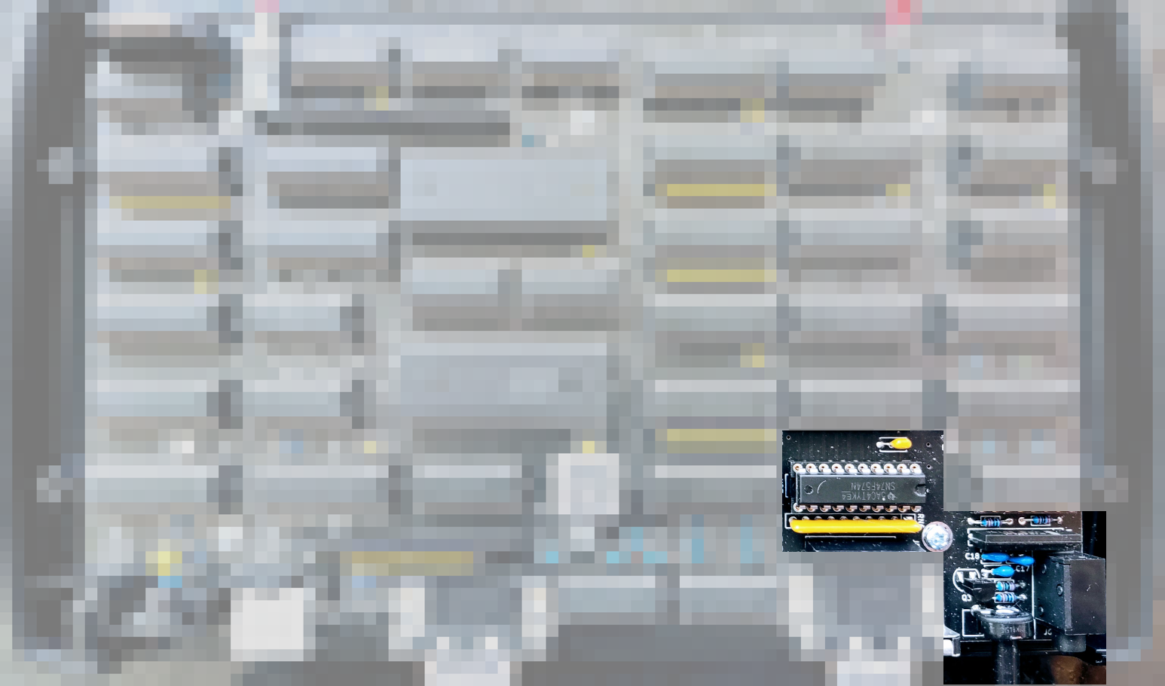
Audio
BLANKING
G Register
R2R DAC
Filter/Amp
Notes:
I've already mentioned the audio. But the glyph register during the blanking filter and amplifier period, is used to read a sample value. There's a little filter and amplifier, so it's actual real pulse code modulation. You get a microsecond pulse at various [voltage] values using this little R2R DAC. Then that has to amplify it and filter it out.

Slide 54
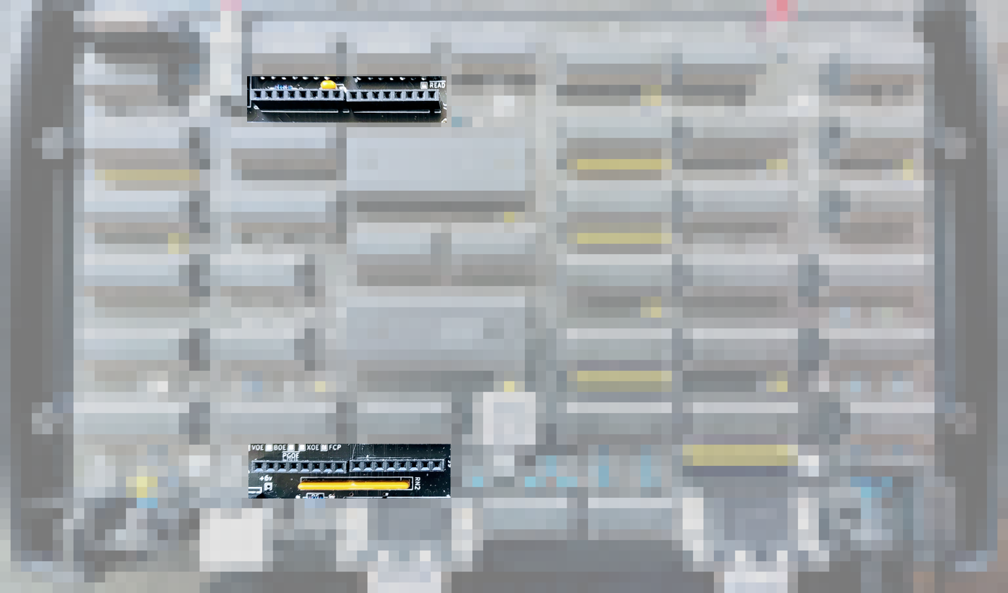
Expansion
IN port 1-7
OUT port 1-7
Notes:
There's also an expansion Port. So there's basically another eight possible registers you can use, and they're actually mapped to the 8080 as [I/O] ports one through seven. The port zero is reserved.

Slide 55
Hardware Abstraction
10
Port# | Input | Output | Notes
8 | Serial Rx (TTY) | Serial Rx (TTY)
9 | Console (KBD) | Console (CRT) | Text mode
10 | KBD Scan Code | Set Audio Mode | Resource control
11 | Character @ cursor pos | Enable/Disable Serial | Resource control
12-55 | Zero Page Read | Zero Page Write | Audio, console params
56-63 | Zero Page Read | N/A | Read only params (RTC)
Notes:
This is how the hardware abstraction happens. The 8080 has this separate address space and there's 256 ports. The first eight are reserved. For this expansion board, port eight is the serial receive and transmit. So you can say to the 8080, give me the next byte of Serial data or [transmit] this byte. Then the abstraction layer takes care of managing the buffers and sampling and all that. There's a console [port] as well, it keeps track of the cursor position, so you can send stuff to a console and it will update the console, the actual screen. It updates the memory, that's all taken care of.
Then there's a couple [of ports additionally.] 10 11 are used for controlling resources, turning on how many audio cycles happening, or enabling disabling the serial. You can actually access a zero page this way. There's [ports 12-55 for] a whole bunch of bytes available on the Zero page. That's things like controlling the audio, setting up the channels. You're just writing through this I/O mechanism. Then there's some additional things which are read only, like the real-time clock and the position of the line counts.

Slide 56
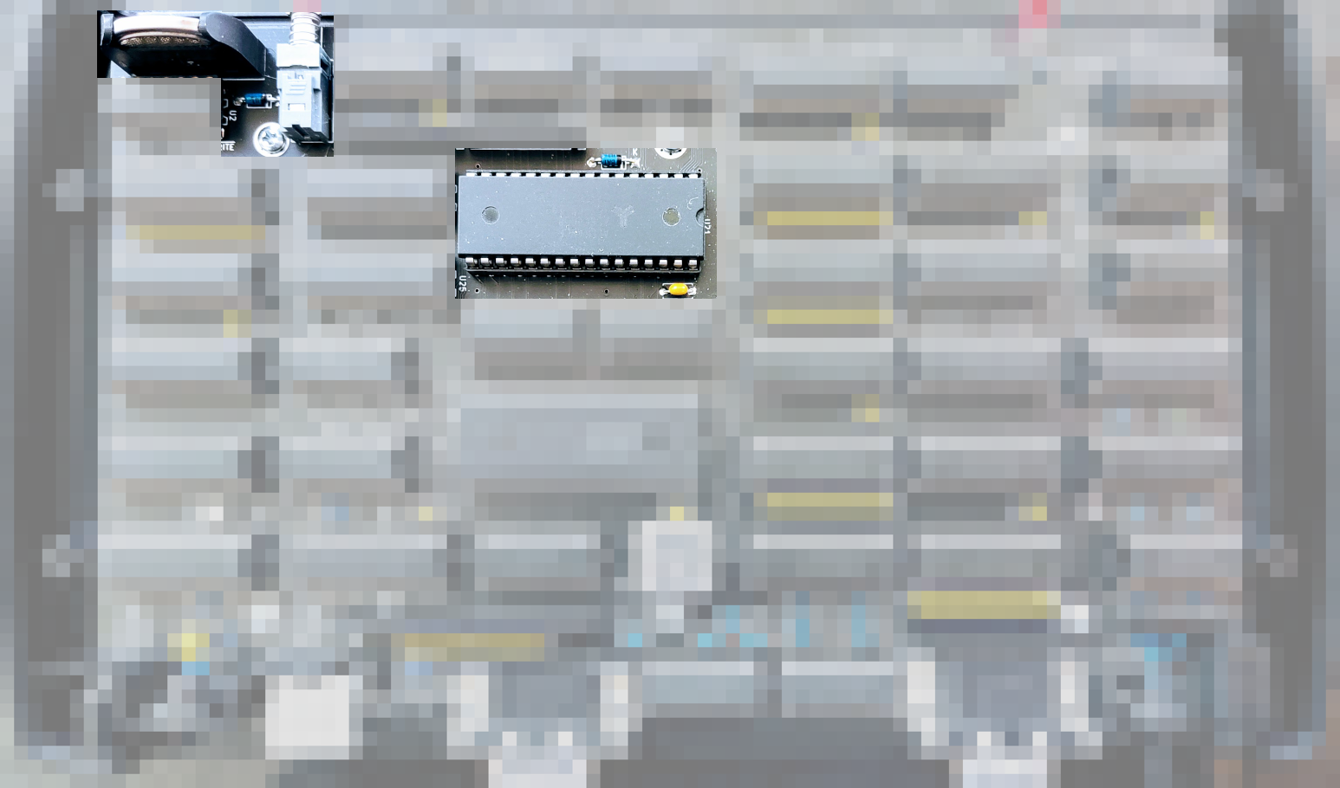
RAM Disk
CR2032 @ 4uA
Notes:
So with CP/M you you need a disk drive. I didn't want to add an SD card, so this is a modern memory. It only uses four microamps in standby mode. When you push the power button and click it off, it puts RAM into standby. There's a CR2032 [battery], and that could potentially keep backup of that RAM for about five years maybe, at least a couple of years. That's a pretty persistent thing.
However, if your program crashes and scribbles all over the memory, it's kind of wrecked. So you have to have some kind of memory management system. But remember, we're in software. This is a virtual machine, like a Java JVM. So we can pretty much do what we like, to segment that memory. We're not running on the hardware. So we can add all sorts of different features for doing that.

Slide 57
A: Drive RAM Disk
BANK x 4
TRACK
8 secs/
track,
254 tracks, 2032 records
Notes:
This is what the actual RAM Disk looks like. I take four 64K Banks of memory. each page is like two records in CP/M, 128 bytes each. I stitched the four pages together to create eight sectors per track, 254 tracks. That's two thousand and thirty two records on that disk, about 254k, which is about right for a 1970s disk.

Slide 58
Memory Management
CPU 0
CPU 1
CPU 2
CPU 3
Video
60k
MICRO KERNEL
CP/M
TTY
CP/M
CRT
SYS
RAM DISK
CPU 4
CPU 5
CPU 6
CPU 7
Notes:
But with memory management, the way I've done it, is I can do actually do preemptive multitasking on this thing, because again it's all in software. So I assign each one of those 64K Banks of memory to a separate CPU. It sounds kind of absurd, but it's it's actually not too difficult. there's a very quick way with the instruction set to switch [banks]. If you keep that Y register the same, you can actually read and write from two bytes adjacent to each other. So I can swap the state very quickly.
So what it's doing, it counts to 100 blocks. When it gets the end of that hundred, then it context switches to another CPU, and you can specify that in another table. So the RAM disk is four separate CPUs [CPU4 thru CPU8], each managing 254 K of RAM.
And we had to have two instances of CP/M. So if you go through the serial terminal, you'll get a CP/M prompt [from CPU2]. That's separate from the one you'll see on the actual [video] CRT [on CPU3]. Then CPU1 is used for that micro kernel. The micro kernel does all of the work. The CP/M's are talking to that microkernel to get to the other CPUs.

Slide 59
System Memory (Bank 0)
SHM 1 … SHM 7
SERIAL & KEYBOARD
BUFFERS
TBD
SHM 0
CONTEXT SEQUENCE
ZERO PAGE
CPU 1 … CPU 7
CPU 0
F0 F1 F2 F3 F4 F5 F6 F7 F8 F9 FA FB FC FD FE FF
00
vCPU
FF
Context Switch
Notes:
So that's what system memory [in Bank 0] looks like. It's a pretty big slide. But basically there's 16 columns [F0 thru FF], column zero isn't really used. There's basically, you have a CPU, and there's a little bit of shared memory. Each CPU can write to its own shared memory, the kernel can transfer stuff between them. The serial keyboard buffers are in there. This context switch sequencer [is in there.]
So the virtual CPU that's running is in this zero page. What it's doing, is context switching by copying from the current state into one of these, and then copying the other one back in. That can be done in under one [code?] block. So you can context switch once per block. That would be potentially be 9600 times a second. And you can yield and then context switch right away. That's how a lot of it works, where it goes to see whether it's got anything to do, and [then] it just yields back. And it just uses up one of those blocks.

Slide 60
A: Drive Read
RECORD
RECORD
CP/M
KERNEL
DISK
Kernel Copy
GET ?
GET 5
RTN 2
RTN ?
2 1 5
Notes:
This is a quick example of a [disk] read and write. This is the A drive, that's the RAM disk. What the CP/M [CPU2] will do, is it'll talk to the kernel and say "I'm going to get this record". It doesn't know where it is, the kernel is going to figure out, that's on disk segment five. So it forwards that on. So for this segment of disk, CPU5 will then copy that into its shared memory then it will return. And the kernel will say "okay I'm gonna copy five to two". Then it sends a return back to the CP/M and says "okay the record's in your memory". Then that CP/M will copy it into its file system [buffer].

Slide 61
A: Drive Write
RECORD
RECORD
CP/M
KERNEL
DISK
Kernel Copy
PUT ?
PUT 5
2 1 5
Notes:
The write's a bit easier. CP/M is going to write it to its shared memory. You're then going to say "put that on the disk drive". The kernel figures out where, copies it across. Then that [disk's] CPU will copy it down into its file system.
There's a few steps here and this is the issue with micro kernels. they tend to do a lot of [switching]. It's not like the monolithic kernel, where it's the actual kernel accesses the disk drive. The kernel here is a traffic cop. But this can run [the disk] at about six kilobytes per second, which is not too bad. It takes 10 seconds to transfer, to load or save 64k, which isn't outrageous for the 70's.

Slide 62
B: Drive
ASM
BASIC - IMSAI 8k BASIC
CPM22 - CCP/BDOS/BIOS
DDT
DUMP
ED
LOAD
PIP
STAT
SUBMIT
UTIL - format, file transfer
XSUB
Boot - bootstrap
Disk - disk client
Kernel - 2k Kernel
Monitor - 2k 8080 Monitor
Notes:
Finally there's a B drive. that storage area in the ROM contains the kind of classic CP/M utilities. I wanted to ship this with BASIC on it. I've only got 8K [for BASIC]. I tried to get the Microsoft [BASIC from] Albuquerque. But then it didn't really work. But I got the IMSAI BASIC, which is from 1977 and that's actually working. [Here's] cp/m 2.2 it's about 7K, and DDT, dump, so all of the CP/M stuff.
Utility is like the very final piece like four years later, this is the last piece, there's a utility function. Typically you'll have a format command, that you can format the a drive. Also to do serial transfer of files in binary mode, that's like the last piece. That B drive also contains a page for the byte boot code. [Also] the actual disk client code for managing the file system. there's the kernel, it has 2K available. That kernel is actually 600 bytes and it's doing all sorts of magic. So it's like really really simple and stripped down. But] it could get up to 2K which is pretty outrageous.
There's also a 8080 machine code monitor which is actually what I demoed 18 months ago here [at VCF]. That's as far as I got then, but that's been very useful. So that's all on that 64k chunk of ROM memory, but the CP/M sees [it as a] 60k B Drive.

Slide 63
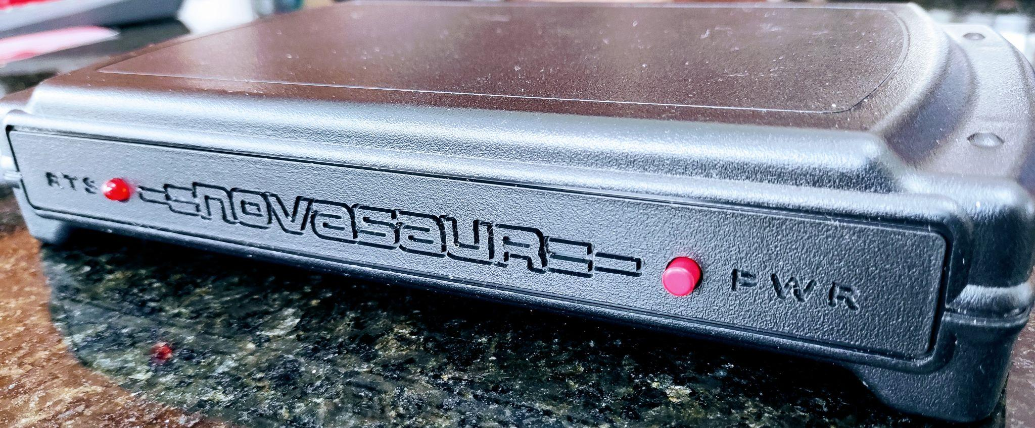
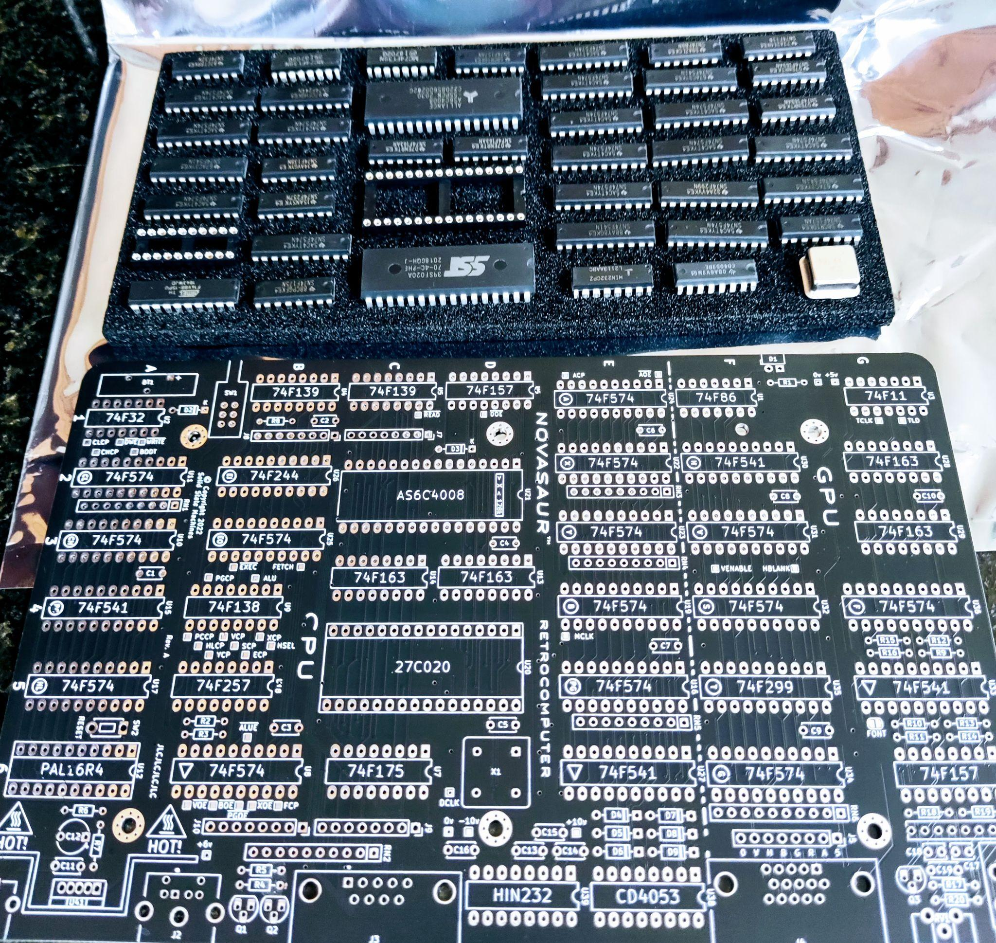
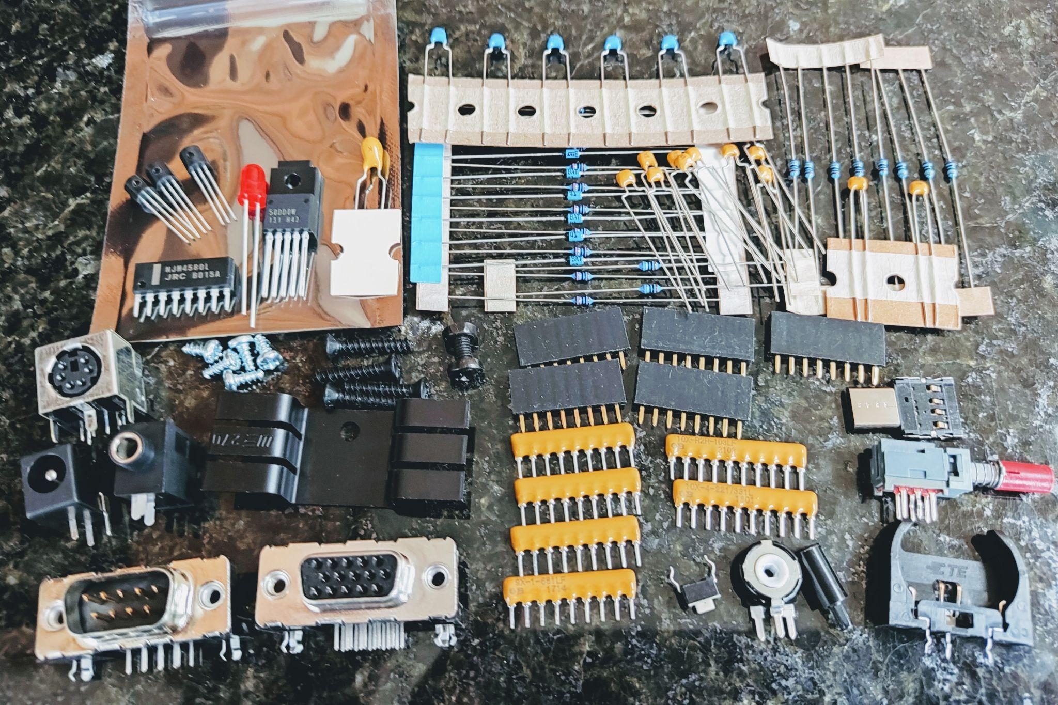
Novasaur Kit
COMING SOON
Notes:
And then there's going to be a kit. Well, there's essentially there are kits. But the software is not quite done it's maybe a few weeks away. And that's what it looks like.

Slide 64
Thank You!
VCF East
https://www.solidstatemachines.com
https://hackaday.io/project/164212-
novasaur-cpm-ttl-retrocomputer
https://github.com/ajhewitt/novasaur
VCF East 2023
Notes:
So that's the project, [at a] kind of still fairly high level. I'm sure it's might have gone over the heads a bit. But I'll be here all weekend, if you want to go into any more details. What I skimmed over, is there's a lot of depth to all of these things, like the actual implementation. There's all sorts of extra things.
Like the video table, it has two things inside it. Basically one table to index it to another. So it has a indirect indexing system. There's 96 different kind of timings and video combinations. It's all a bit ridiculous.
This is the sort of the business [slide for] Solid State Machines. I've been documenting this on Hackaday since day one, it's sort of stream of consciousness. So [some of] it is very early on, some early ideas which disappeared [later]. But generally each log has a complete idea, or there's the final implementation. It might have drifted a little bit [over time].
All the code is [available on github,] if you want you want to see what it looks like. It's about the actual virtual machine. That virtual machine code, is pretty much the only program that ever gets written to run on the hardware. Then people will use the 8080 machine code. I don't think that normal people would actually want to get into the weeds. It's really obnoxious to break everything up into these 43 cycle blocks. That code is about five thousand lines technically. It took, I don't know, a couple of years to write and debug. Actually it took six months to write and 18 months to debug it, something like that.
This is a very big software project, but now it's actually done. So this is actually the machine [shows Rev A board]. I got this standard case, so I'm not 3D printing anything. But I have a CNC machine I can engrave [with, and] that's what it looks like.
I'm thinking about doing a surface mount version [next]. But I want to take it to another level, where I can actually break all this down into single discrete gates. So you get these little SOT-23 packages. It would have about 350 of those. It could theoretically work. Maybe end of the year, I'll start looking at that but I think that's it.

